Slide 1
Intel AI SDK
Luke.Su
Embedded Computing Group
May, 2018

Slide 2
Outline
What’s inside the Intel Computer Vision SDK
Inference Engine
Compare performance
Batch Support
Intel® Integrated Performance Primitives (Intel® IPP)
Goals

Slide 4
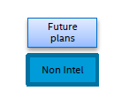
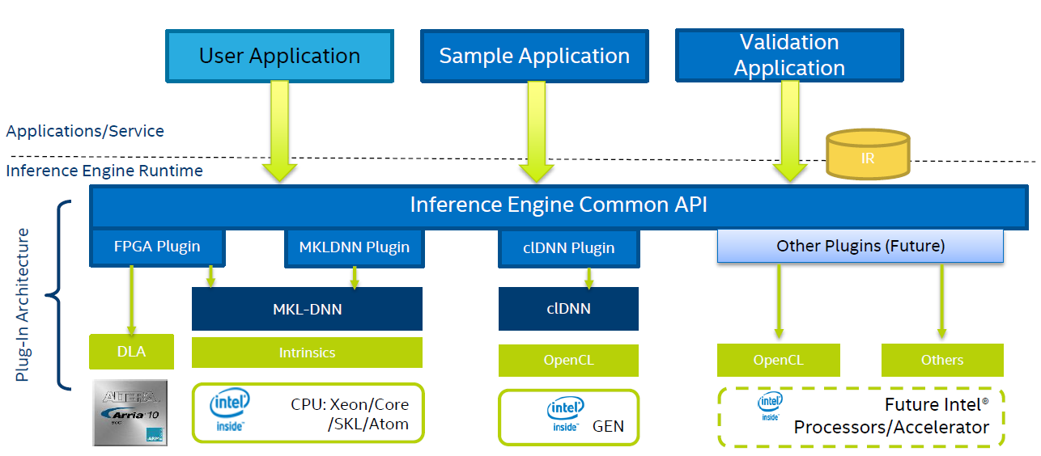
Inference Engine Plugins

Slide 5
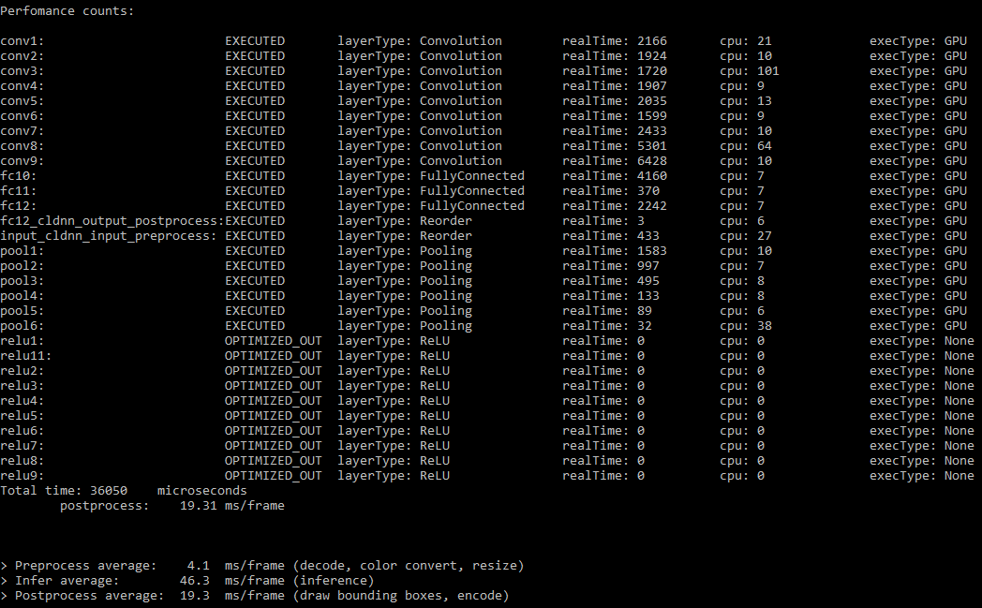
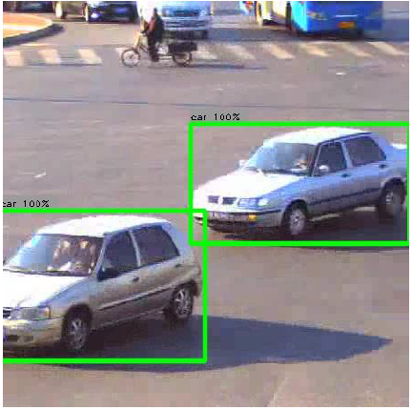
Inference on CPU or GPU performance
Inference on CPU
Total time: 64.5ms
Inference on GPU
Total time: 36.1ms
Platform: AIMB-275
CPU: Intel Core i3-6100

Slide 6
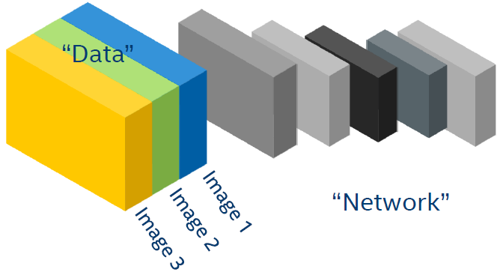
Batch Support

Slide 7
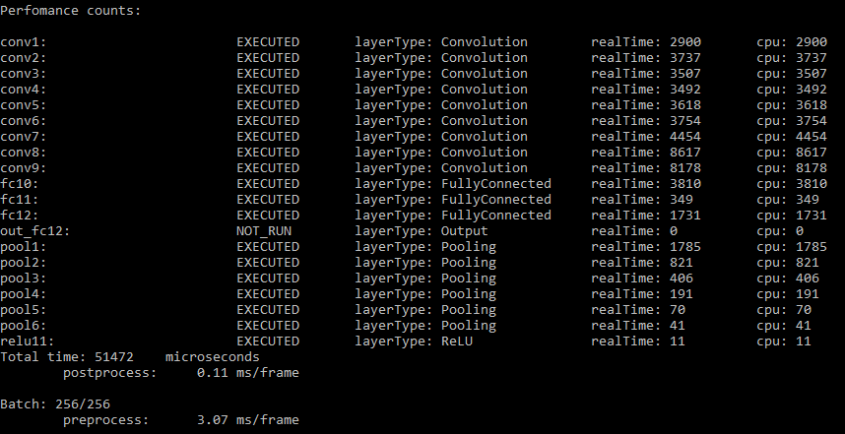
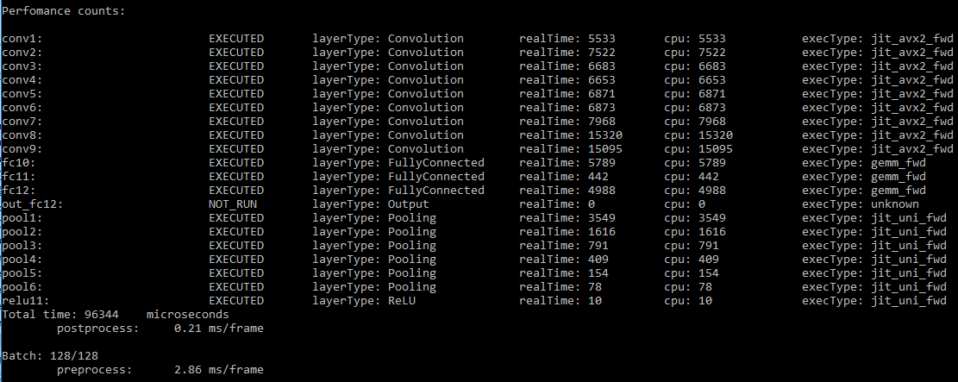
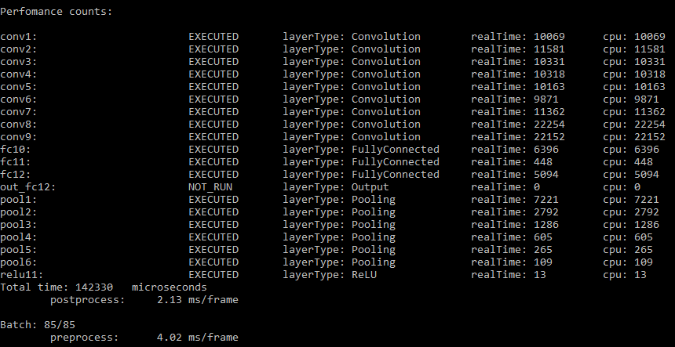
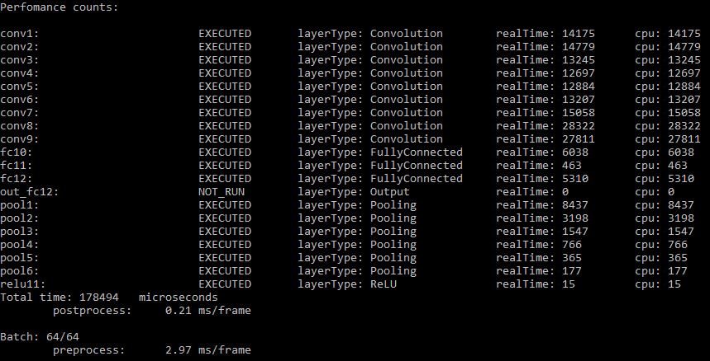
Batch Support
1 inference = 51.4ms / 1
1 inference = 96.3ms / 2 = 48.15ms
1 inference = 142.3ms / 3 = 47.4ms
1 inference = 178.5ms / 4 = 44.6ms

Slide 8
Integrated Performance Primitives
IPP offers developers for image processing, signal processing, and data processing applications
IPP offers thousands of optimized functions covering frequently used fundamental algorithms
Wide range of Intel architecture
(Intel® Quark™, Intel Atom®, Intel® Core™, Intel® Xeon®, and Intel® Xeon Phi™ processors)

Slide 9
Integrated Performance Primitives
Signal Processing
Transform Functions : DFT, FFT
Filtering Functions : Convolution, Filtering
Data Compression
Dictionary-Based Compression Functions : Lempel-Ziv-Storer-Szymanski (LZSS), LZ77 (Zlib), Lempel-Zib-Oberhumer (LZO)
BWT-Based Compression Functions : bzip2
Image Processing
Image Statistics Functions : Integral, SqrIntegral, histogram

Slide 10
Goals
Phase 1.
Can run CPU/GPU of Inference Engine to process on Advantech platform.
Future
Help customer to build development CV SDK device.
Using OTA update AI module.

