Slide 1
KubeEdge
Introduction
Eric.Liang, ESS-EdgeSense, Embedded-IoT
2019/03/26

Slide 2
Agenda
Overview
Architecture
How To
Release & Roadmap
WISE-PaaS/EdgeSense on k8s with KubeEdge

Slide 3
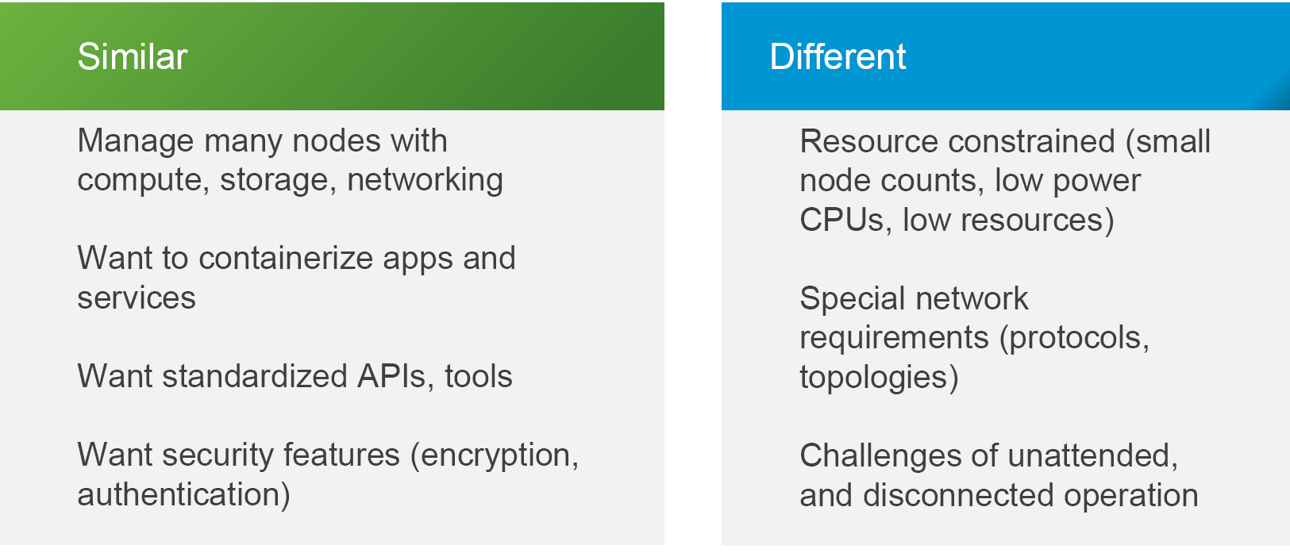
Cloud vs. Edge

Slide 4
Overview
An opensource project contributed / started by Huawei. https://github.com/kubeedge
KubeEdge allows customer to manage edge nodes,
deploy / orchestrate / monitor apps etc. the same way as in the cloud.
KubeEdge contains components running at cloud and edge.
Both, edge and cloud parts are now opensourced. ( Apache-2.0)

Slide 5
K8S - Architecture

Slide 6
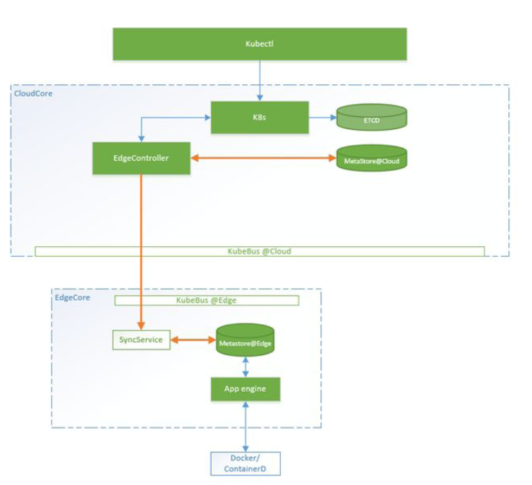
KubeEdge - Architecture
Multi-tenancy, large scale of distributed edge nodes/applications.
Lightweight agent (Footprint10-20MB, RAM: 20-25 MB) , container native
Duple/multiplex cloud/edge network connection
Device twin, mqtt/http device & edge connection
Edge side autonomy

Slide 7

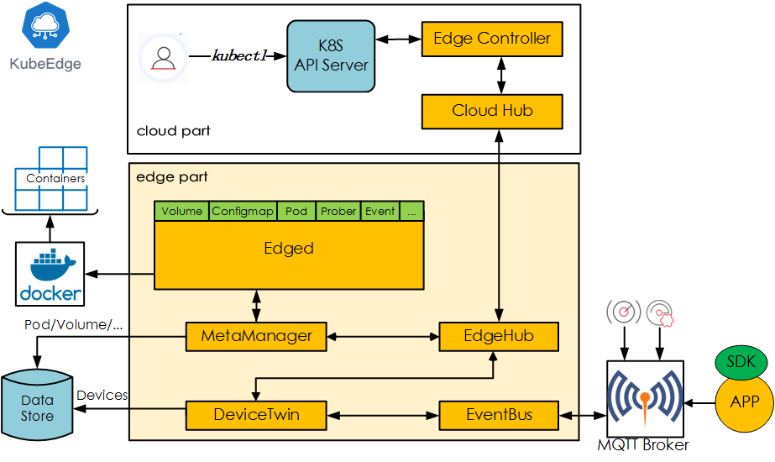
Architecture of KubeEdge
Manages the Edge nodes. It is an extended Kubernetes controller which manages edge nodes and pods metadata so that the data can be targeted to a specific edge node.
Communication interface module at the Cloud. A web socket server (10000) responsible for watching changes on the cloud side, caching and sending messages to EdgeHub
Manages containerized Applications at the Edge
Communication interface module at the Edge. It is a web socket client responsible for interacting with Cloud Service for edge computing
It manages the metadata at the edge node. This is the message processor between edged and edgehub. It is also responsible for storing/retrieving metadata to/from a lightweight database (SQLite).
It is software mirror for devices that handles the device metadata. This module helps in handling device status and syncing the same to cloud. It also provides query interfaces for applications, as it interfaces to a lightweight database (SQLite).
Handles the internal edge communications using MQTT. It is an MQTT client to interact with MQTT servers (mosquitto), offering publish and subscribe capabilities to other components

Slide 8
Architecture of KubeEdge
0.2 release

Slide 9
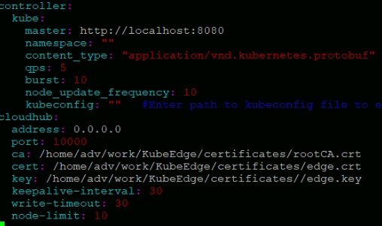
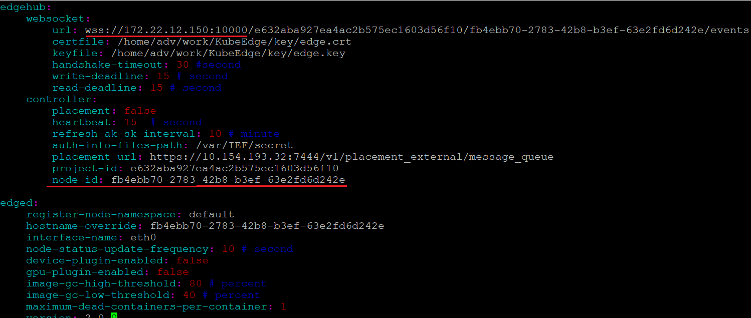
KubeEdge Config
Cloud
Edge: fb4ebb70-2783-42b8-b3ef-63e2fd6d242e

Slide 10
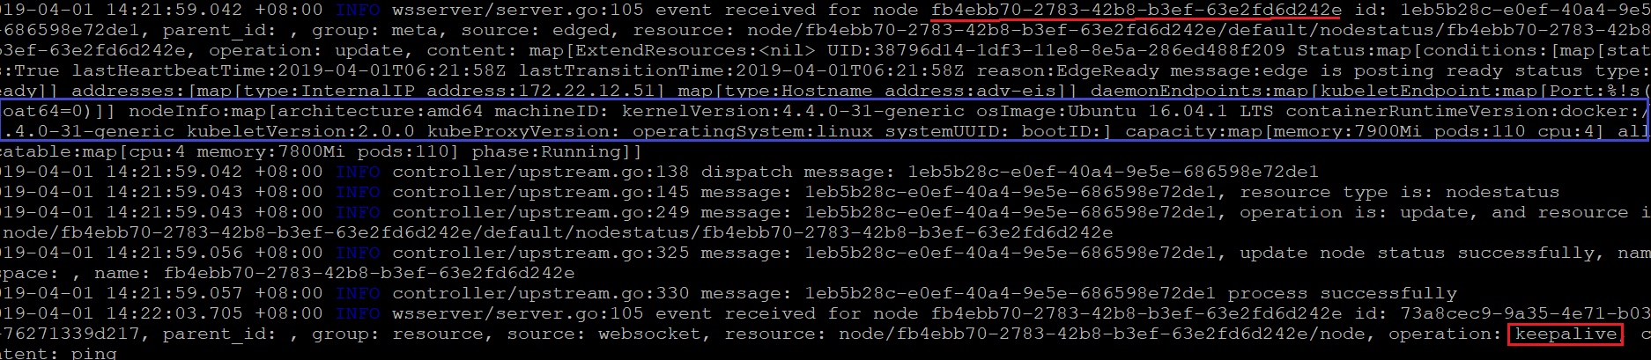
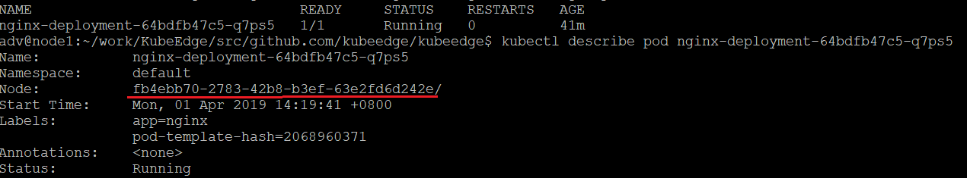
Deployment a Node & Pod
Edge Controller Log
Deployment a k8s Node
Deployment a nginx pod

Slide 11
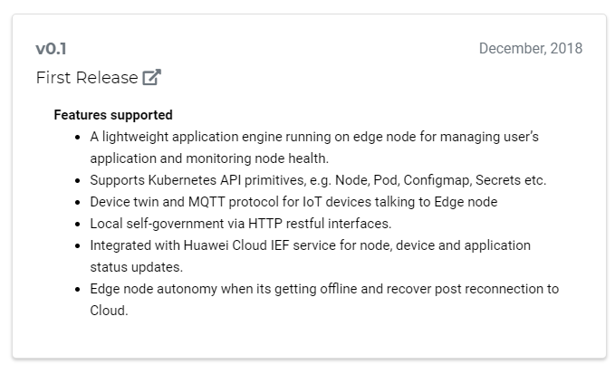
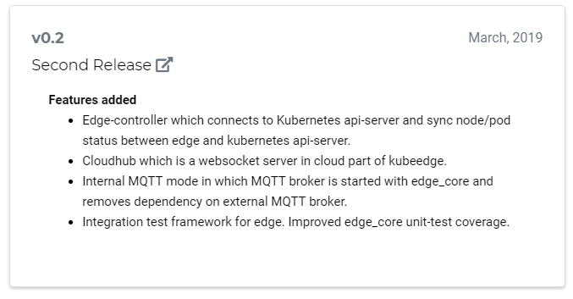

Release

Slide 12
Roadmap
Release 1.0
KubeEdge will provide the fundamental infrastructure and basic functionalities for IOT/Edge workload. This includes:
K8s Application deployment through kubectl from Cloud to Edge node(s)
K8s configmap, secret deployment through kubectl from Cloud to Edge node(s) and their applications in Pod
Bi-directional and multiplex network communication between Cloud and edge nodes
K8s Pod and Node status querying with kubectl at Cloud with data collected/reported from Edge
Edge node autonomy when its getting offline and recover post reconnection to Cloud
Device twin and MQTT protocol for IOT devices talking to Edge node
Release 2.0 and Future
Build service mesh with KubeEdge and Istio
Enable function as a service at Edge
Support more types of device protocols to Edge node sunch as AMQP, BlueTooth, ZigBee, etc.
Evaluate and enable super large scale of Edge clusters with thousands of Edge nodes and millions of devices
Enable intelligent scheduling of apps. to large scale of Edge nodes
etc.

Slide 13
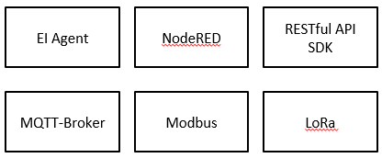
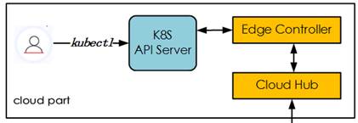
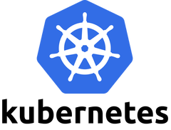
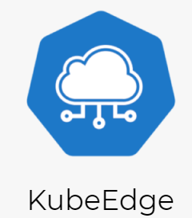
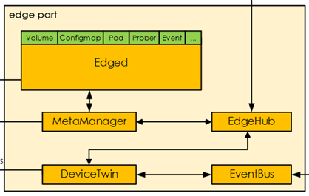

WISE-PaaS/EdgeSense k8s with KubeEdge
WISE-PaaS/DeviceOn
Cloud
Edge
EI Agent
Container
MQTT-Broker
Container
Modbus
Container

Slide 14
Go Together,
We Go Far and Grow Big

