Slide 1
Introduction of IDP 3.x
Embedded Core Group
Eric.Liang
2015/10/20

Slide 2
Outline
Intel IoT Gateway ( Wind River )
IDP 3.x Helix Device Cloud
IDP 3.x System
Validation & Diagnostic

Slide 3
Intel IoT Gateway
( Wind River )

Slide 4
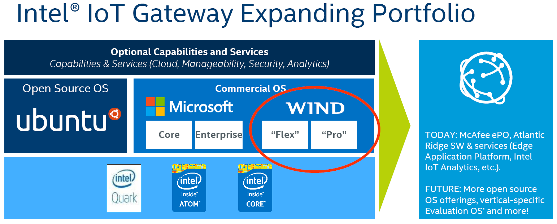

Slide 6
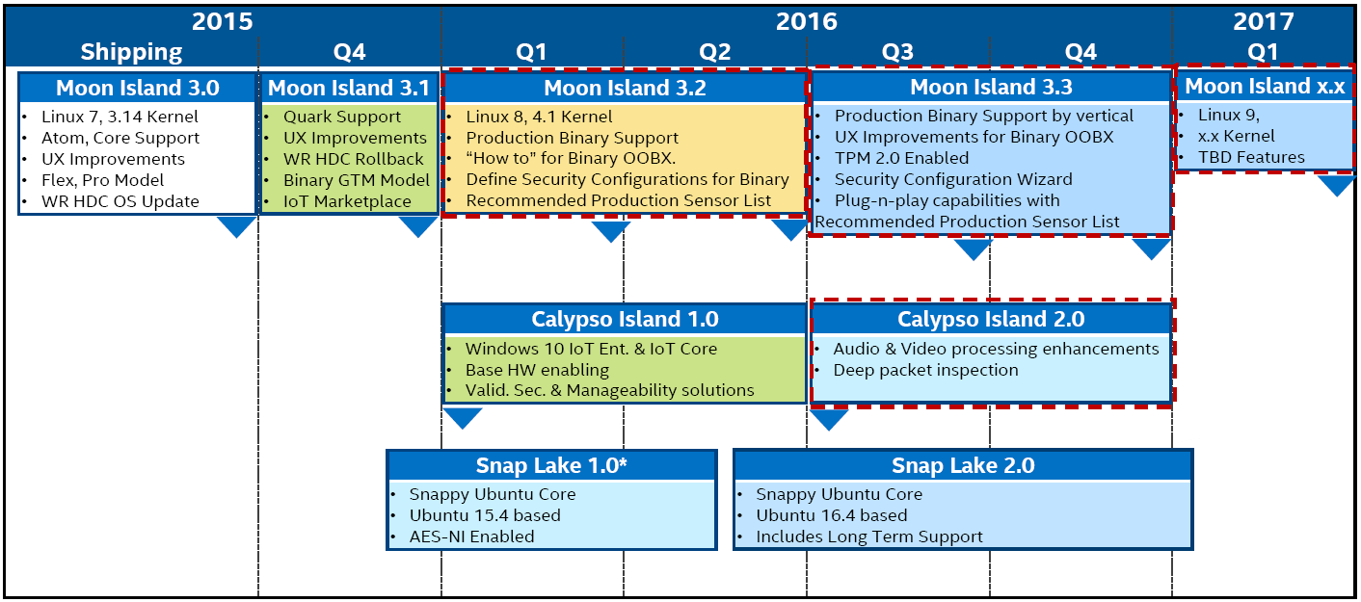

Slide 8
Helix Device Cloud

Slide 10
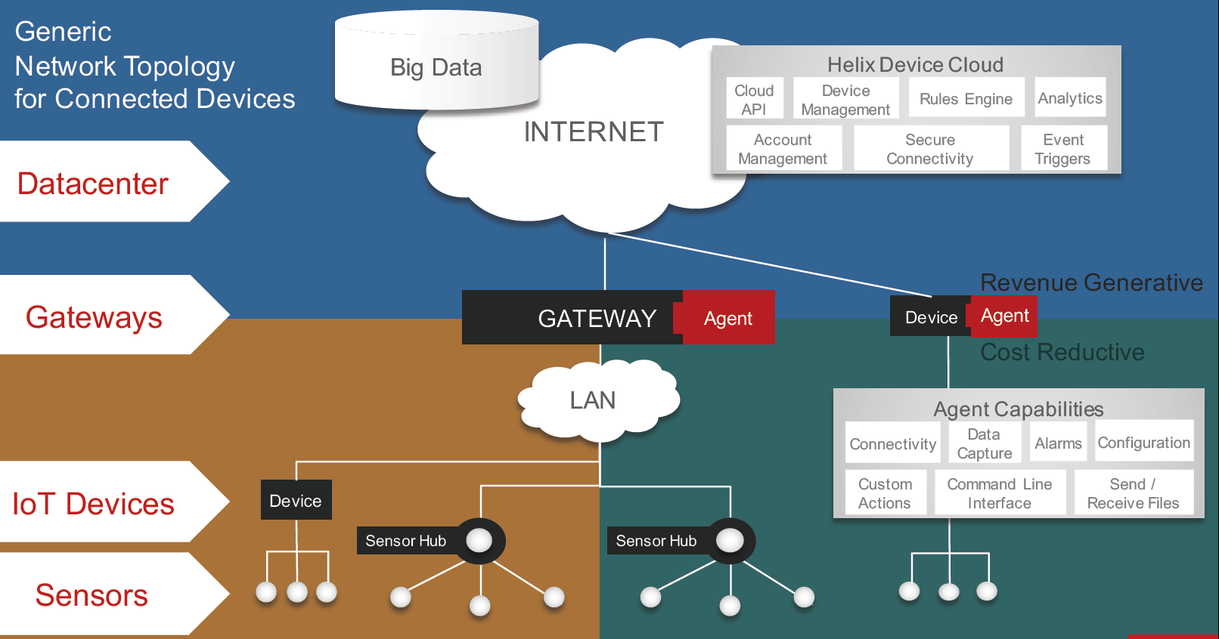

Slide 12
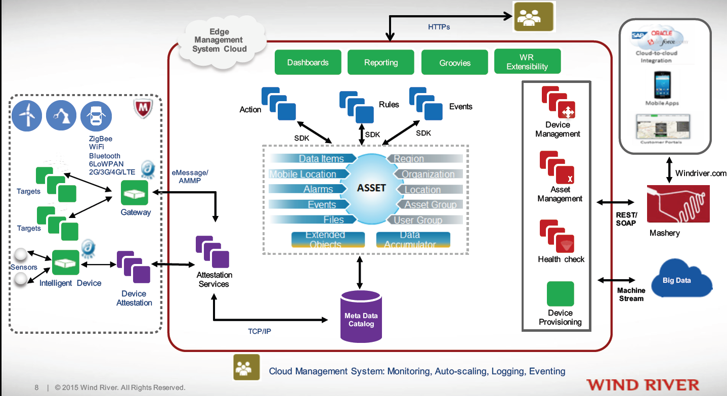

Slide 14
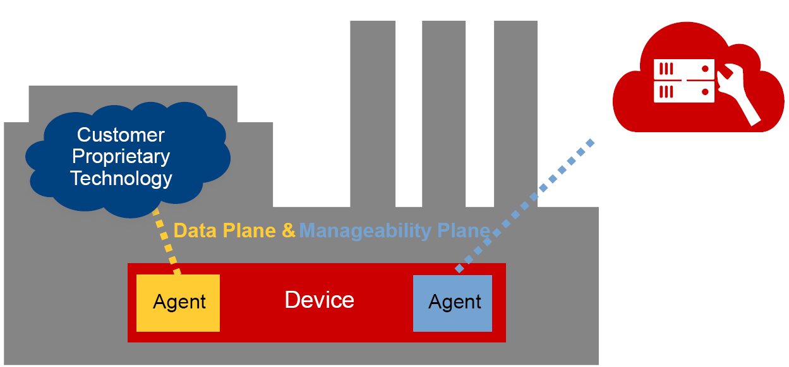
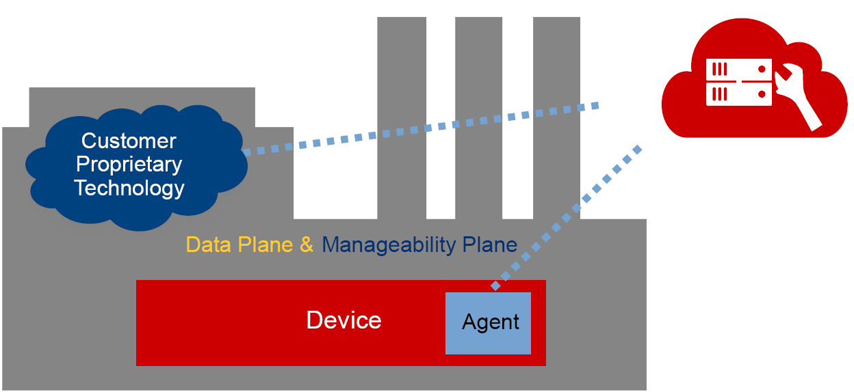

Slide 15
IDP3.0 System

Slide 16
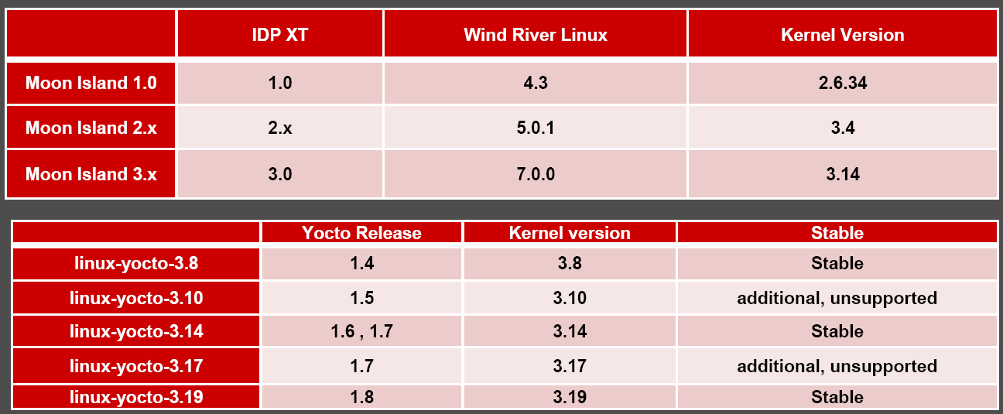
Version of IDP / WR Linux, Kernel, Yocto

Slide 18
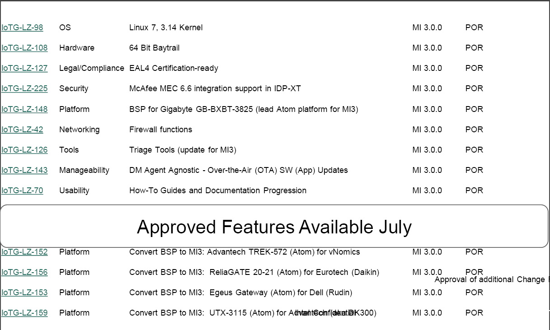

Slide 19
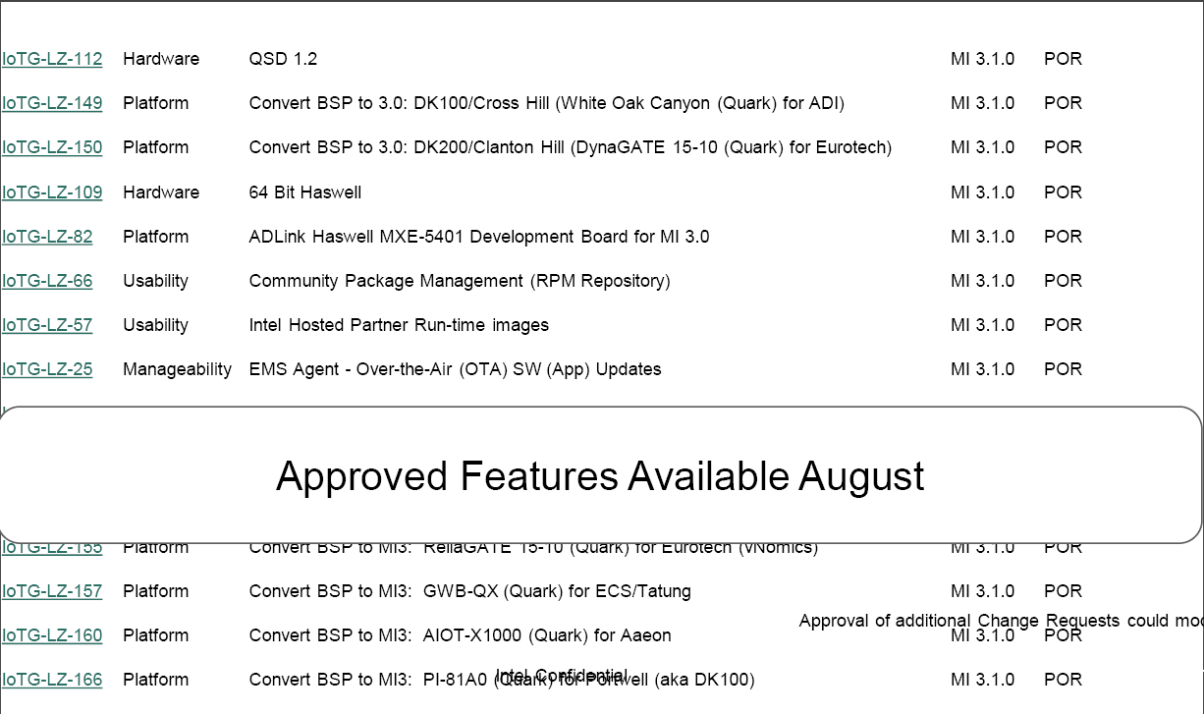

Slide 20
Validation
& Diagnostic

