Slide 1
EdgeX - DeviceService
Terry.Lu, ESS-EdgeSense, Embedded-IoT
2018/01/03

Slide 2
Agenda
Device Service Configuration
Device Configuration
Callback
Protocol

Slide 3
configuration.toml
Define the config of DeviceService

Slide 4
configuration.toml
Configure current data service feature
[Service]
Host = "localhost"
Port = 49992
ConnectRetries = 3
Labels = []
OpenMsg = "device simple started"
ReadMaxLimit = 256
Timeout = 5000
EnableAsyncReadings = true
AsyncBufferSize = 16
config.Service.Host
config.Service.Port

Slide 5
configuration.toml
Configure registry that will register to Consul
[Registry]
Host = "localhost"
Port = 8500
CheckInterval = "10s"
FailLimit = 3
FailWaitTime = 10
common.CurrentConfig.Registry.Host
common.CurrentConfig.Registry.Port

Slide 6
configuration.toml
Configure basic service info for DeviceService client
[Clients]
[Clients.Data]
Name = "edgex-core-data"
Protocol = "http"
Host = "localhost"
Port = 48080
Timeout = 5000
[Clients.Metadata]
Name = "edgex-core-metadata"
Protocol = "http"
Host = "localhost"
Port = 48081
Timeout = 5000
[Clients.Logging]
Name = "edgex-support-logging"
Protocol = "http"
Host = "localhost"
Port = 48061
common.CurrentConfig.Clients[common.ClientData].Host
common.CurrentConfig.Clients[common.ClientMetadata].Host
config.Clients[common.ClientLogging].Host

Slide 7
configuration.toml
Configuration about sensor
[Device]
DataTransform = true
InitCmd = ""
InitCmdArgs = ""
MaxCmdOps = 128
MaxCmdValueLen = 256
RemoveCmd = ""
RemoveCmdArgs = ""
ProfilesDir = "./res"
Apply default transfer rule for read/write value
common.CurrentConfig.Device.DataTransform
common.CurrentConfig.Device.ProfilesDir
Path to yaml profile

Slide 8
configuration.toml
Configure logging policy
Logging to file or to logging service
[Logging]
EnableRemote = false
File = "./device-simple.log"
Level = "DEBUG"
common.CurrentConfig.Registry.Host
common.CurrentConfig.Registry.Port

Slide 9
configuration.toml
Configure schedule & schedule event
[[Schedules]]
Name = "10sec-schedule"
Frequency = "PT10S"
config.Schedules
Period to pulling sensor data and put to core-data
[[ScheduleEvents]]
Name = "readRandom"
Schedule = "10sec-schedule"
[ScheduleEvents.Addressable]
HTTPMethod = "GET"
Path = "/api/v1/device/name/RandNum-Device01/Random"

Slide 10
configuration.toml
Configure Devices
[[DeviceList]]
Name = "RandNum-Device01"
Profile = "RandNum-Device"
Description = "Random Number Generator Device"
Labels = [ "random", "test" ]
[DeviceList.Addressable]
Address = "random"
Port = 300
Protocol = "OTHER"
Device name
The name of device profile (yaml file)

Slide 11
random-generator-device.yaml
name: "RandNum-Device"
manufacturer: "Dell Technologies"
model: "1"
labels:
- "random"
- "test"
description: "random number generator to simulate a device"
Device profile name

Slide 12
random-generator-device.yaml
commands
REST API
resources
Device Service function
deviceResources
deviceResources
…
Data format

Slide 13
random-generator-device.yaml
deviceResources:
-
name: "randomnumber"
description: "generated random number"
attributes:
{ type: "randdom" }
properties:
value:
{ type: "INT32", readWrite: "R", defaultValue: "0.00", minimum: "0.00", maximum: "100.00" }
units:
{ type: "String", readWrite: "R", defaultValue: "" }
resources:
-
name: "Random"
get:
-
{ operation: "get", object: "randomnumber", property: "value", parameter: "Random" }
set
-
{ operation: “set", object: "randomnumber-SET", property: "value", parameter: "Random-SET" }
No used
Name of descriptor that register to metadata

Slide 14
random-generator-device.yaml
commands:
-
name: "Random"
get:
path: "/api/v1/device/{deviceId}/Random"
responses:
-
code: "200"
description: ""
expectedValues: ["Random"]
-
code: "503"
description: "service unavailable"
expectedValues: []
resources name
deviceResource name

Slide 15
random-generator-device.yaml
{deviceId}
The name defined in DeviceList
name/RandNum-Device01

Slide 16
callback
DisconnectDevice
When a device is removed from the device service.
Initialize
HandleReadCommands
Read sensor data
HandleWriteCommands
Write sensor data
Stop
When device service stoped

Slide 18
Protocol

Slide 19
Protocol Flow
Ping
Health check
List service
Logging
Get current valuedescriptor(value type, max, min)
Add new valuedescriptor

Slide 20
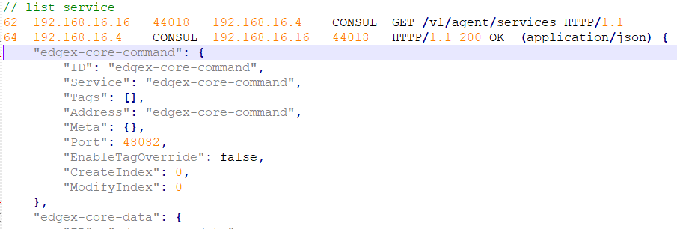
Protocol – Ping, List Service

Slide 21
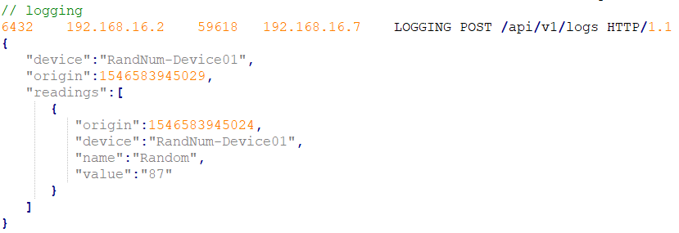
Protocol - Logging

Slide 22
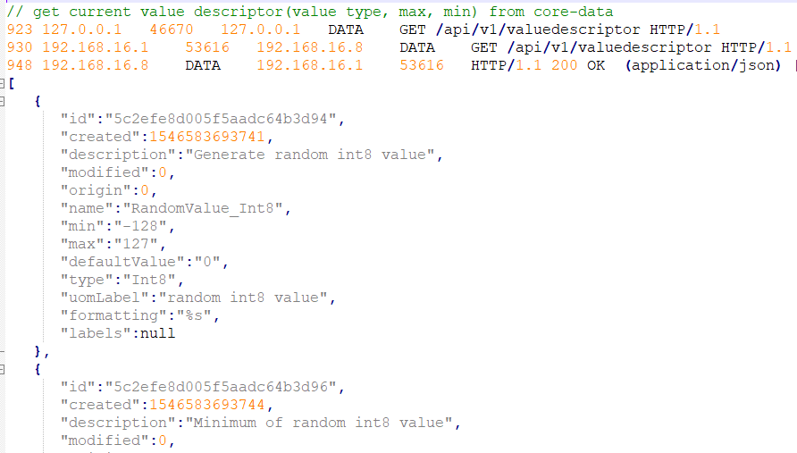
Protocol – Value Descriptor

Slide 23
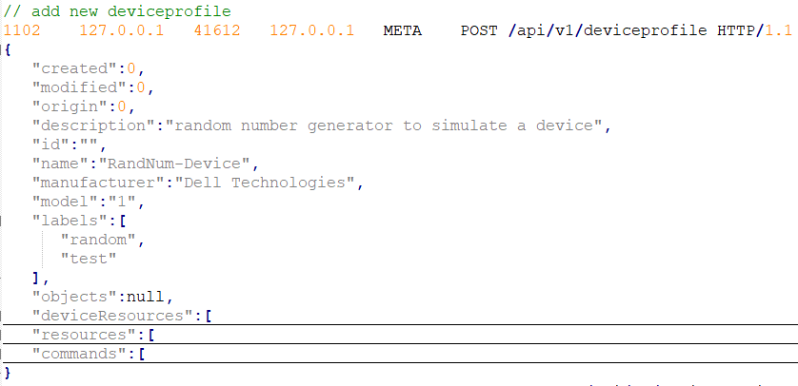
Protocol – Device Profile

Slide 24
Protocol Flow
Try to get deviceservice addressable
Add deviceservice addressable
Try to get deviceservice
Add deviceservice
Get current deviceprofile
Add new deviceprofile

Slide 25
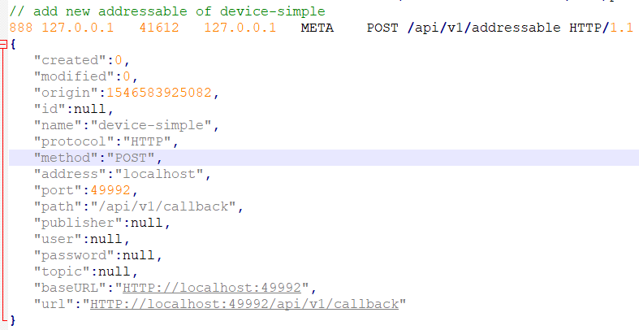
Protocol – DeviceService Addressable

Slide 26
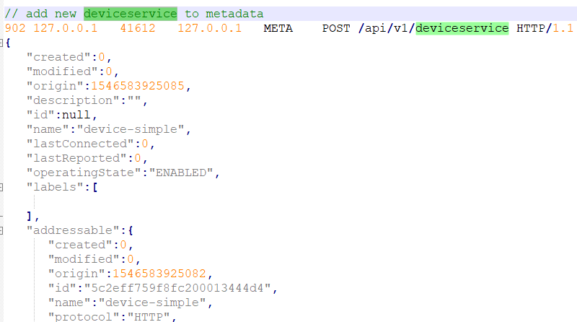
Protocol - DeviceService

Slide 27
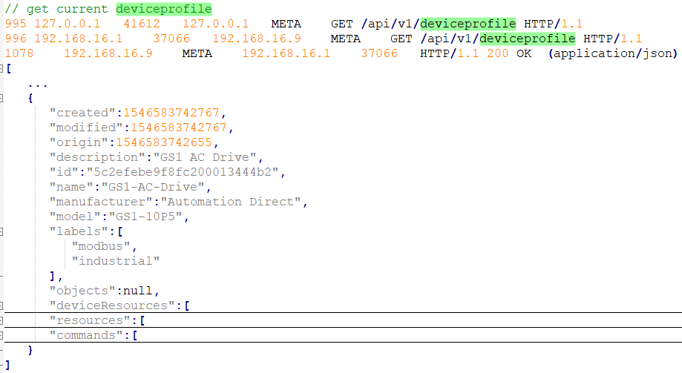
Protocol – Device Profile

Slide 28
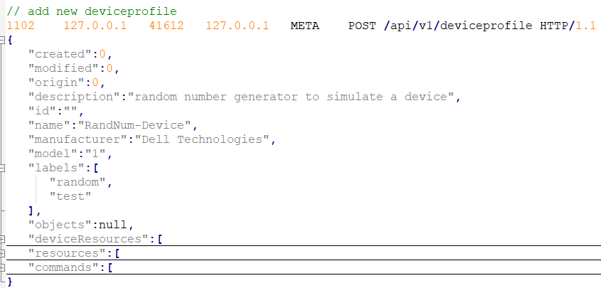
Protocol – Device Profile

Slide 29
Protocol Flow
Try to get device addressable
Add device addressable
Try to get device
Add device
Metadata send device change event to notification

Slide 30
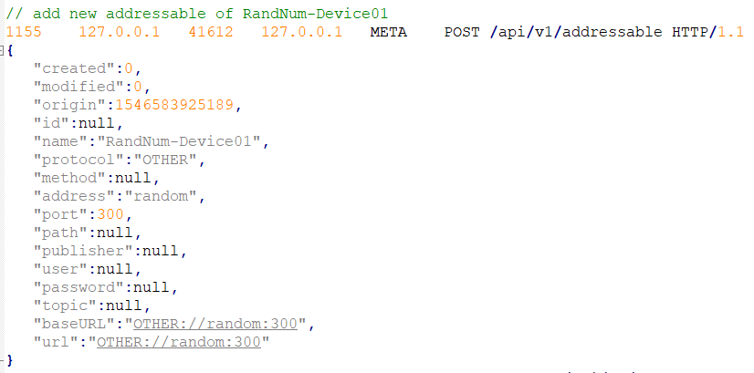
Protocol – Device Addressable

Slide 31
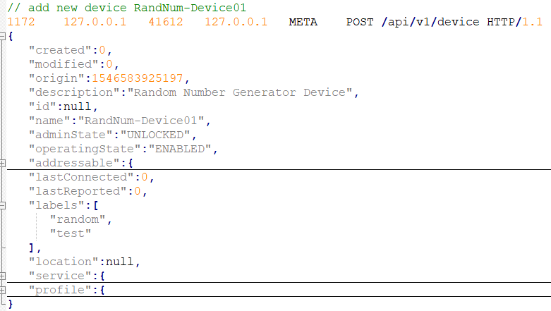
Protocol - Device

Slide 32
Protocol - Notification

Slide 33
Protocol Flow
Try to get schedule
Add new schedule
Try to get scheuleevent addressable
Add new scheduleevent addressable
Try to get scheuleevent
Add new scheduleevent
Post event (data report)

Slide 34
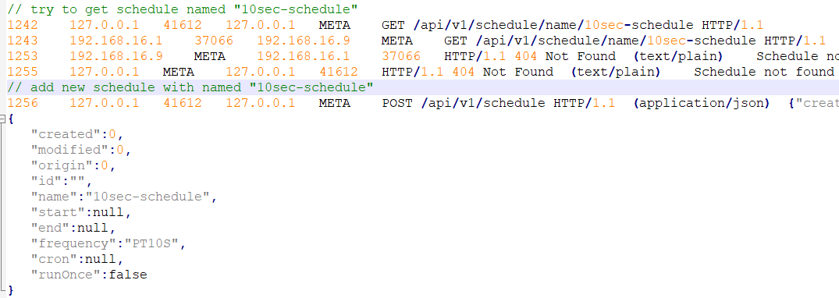
Protocol – Schedule

Slide 35
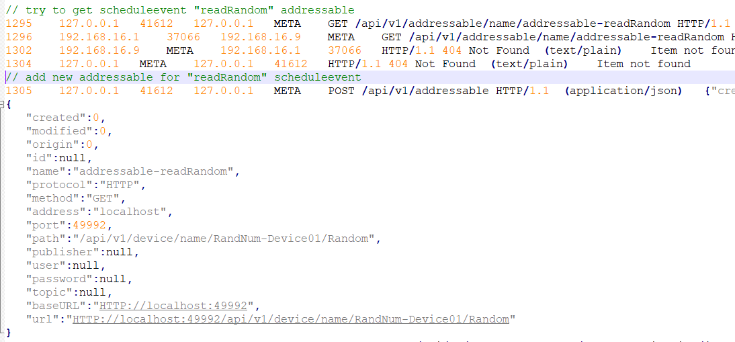
Protocol – Schedule Event Addressable

Slide 36
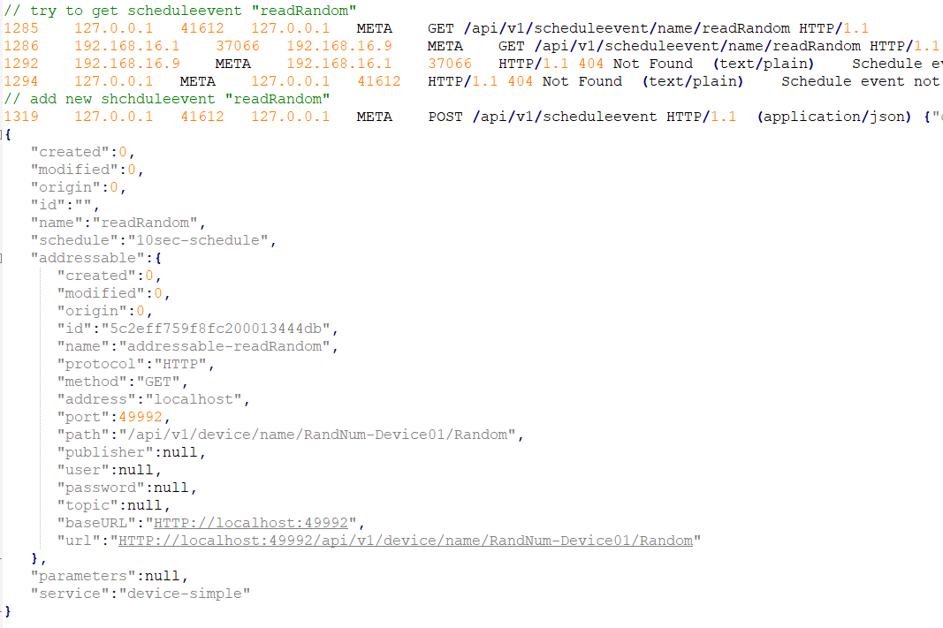
Protocol – Schedule Event

Slide 37
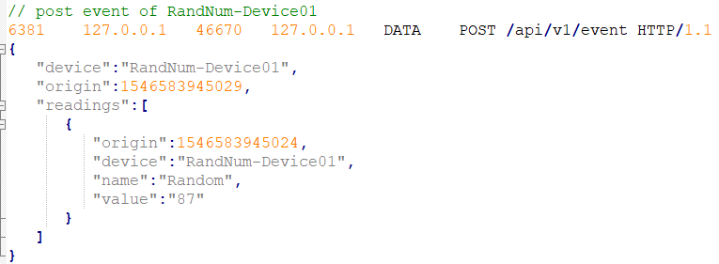
Protocol – Event (Data Report)

Slide 38
Go Together,
We Go Far and Grow Big

Slide 39
