Slide 1
復盛 Go-Service Agent + Modbus on EIS
Advantech
Jan, 2018

Slide 2
Agenda
Overview
Target & Task
Feasibility Evaluation
Requirement

Slide 3
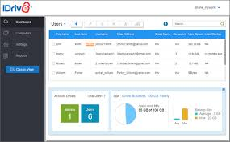
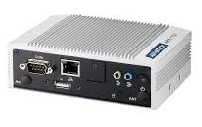
Overview
Go-Server
MQTT
Script x 40
gsDispatcher
Config for Modbus
Modbus RTU

Slide 4
Target & Task
Porting
Agent + Scripts : IDP to another Linux
Downlink Control
Cloud -> Agent ( 復盛 )
Agent -> Modbus Device
Functional Verification ( Owner ? )

Slide 5
Feasibility Evaluation
Platform & Peripherals
COM
Networking – Eth, WiFi, 3G …
Linux Distribution ( IDP / Ubuntu ? )
Shell Scripts x 40
Application ( gsDispatcher )
Verification
Function Specification ( Cloud / Local / Modbus )
HW device ( Modbus device, Net …)

Slide 6
Requirement
Document
User Manual
Functional Specification
SW Specification
SW Design Doc.
Technique Contact Window
HW Devices
Platform
Modbus devices…

