Slide 1
ESL Server Spec.
WISE-EC
Oct, 2017

Slide 2
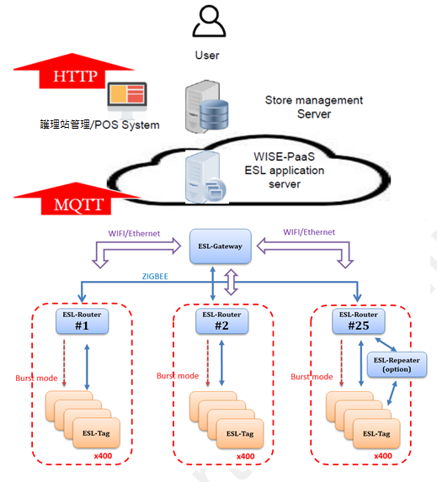
ESL System Architecture 1/ 2
Application Server
ESL Server
Gateway
Router
ESL

Slide 3
Outline
ESL SW Architecture
ESL Server Requirement List
Device Management
Service Management
Account Management
External Data Exchange Interface
Image Generator
Competitor’s UI
Competitor1
Item/Device Management
Report
Competitor2
Item/Device Management
Image Generator

Slide 4
Gateway SW Architecture
SW Owner :
1.Gsmartek in OSAL & OpenWRT’s Tag Mgt SW in Red.
2.CharlesH in GUI.
GUI
Device Mgt
Service Mgt
Gateway config
WIFI/Ethernet
Connectivity: Zigbee
System Tasks
Application layer
Application Layer
Zigbee Device
Object
AF: Tag ApplicationObject:
-Send Data
-Received Data
OS Abstraction Layer APIs
MQTT broker
WISE-agent
ZDP: Device & service discovery
Task registration
Security AAA/VPN/Firewall
initialization and starting
APS
Gateway Device/Service/account Mgt SW & API
Build group
End point binding
OTA frame
Task synchronization
Message exchange between tasks
Nwk
Layer
Network Layer
DHCP
Handshaking
Route discovery
Distributed address
Interrupt handling
Routing
Route Maintenance
Mac
WAN/LAN Config
Mac
Port
Mgt
Jumbo frame
Encryption
Data Service
Mgt PANs
Mgt Service
Frame Security
Timer
Memory allocation
OpenWRT
Mini PEIe
OSAL
Power management
WISE-3640
Timer
RTC
UART
Flash
DDR
USB
RF2.4G
IPQ4029
MCU / RF Chip: TI CC2538

Slide 5
Admin. Operation on Cloud/ESL Server
ESL Server
RESTful
API
Database
Tag Mapping Data
-update TAG data & schedule
GUI
Admin
統操作端
Device Mgt
1. Device monitor
-Tag battery alert
-Tag status report
2.Remote control
-import tag-list for legal join
Service Mgt
-FTP:OTA FW /image to device
-Execute action
e.g. tag image update : schedule / image generate
Account Mgt
Account
Account Role
Permission for account and Role/group
Image Generator
1.Generate image file (full and partial) and preview
2.Image file transform to ESL system’s format and zip
3. Provide Api for tag image update
WISE-3640
Gateway
API
GUI
Device Mgt
1. Device monitor
-Tag battery alert
-Tag status report
2.Remote control
-Provide tag-list for router
-Tag/Router join
Service Mgt
-FTP: OTA FW/image to Tag/Router
-Execute action on Tag/Router
e.g. tag image update : schedule / image generate
Device Mgt :
-device monitor,Remote control
Service Mgt
-OTA FW & image
Gateway Config
WISE-3240
Router
Device Mgt
Build group : connect to gateway
End point binding
Service Mgt
FTP: OTA FW/image to tag
FTP: OTA FW on Router

Slide 6
End user Operation on 醫護系統
POS/醫護系統操作端
ESL
Server
Database
Device Mgt
1. Device monitor
-Tag battery alert
-Tag status report
2.Remote control
-import tag-list for legal join
Service Mgt
-FTP:OTA FW /image to device
-Execute action
e.g. tag image update : schedule / image
Account Mgt
Account
Account Role
Permission for account and Role/group
RESTful
API
Mapping list
Tag Mapping Data
Update to ESL Server
-update data of the Tag
-update schedule of the Tag
Schedule
價錢
data
Image
generator
1.Layout editor
第一次需排版ESL畫面,
定義區塊 ->資料
A (X,Y,X長度,Y長度) ->品名
B (X,Y,X長度,Y長度) ->價錢
C (X,Y,X長度,Y長度) ->貨號
D (X,Y,X長度,Y長度) ->庫存
2.Image generate
3.Image transformer
更新價錢
在區塊B
1. Image transformer
2.Compression
From Gsmartek.
排版
產出圖檔
版型
版型
B (X,Y,X長度,Y長度) ->價錢
Notes:
Image Generator
1. ESL 排版軟體 定義區塊
A (X,Y,X長度,Y長度) ->品名
B (X,Y,X長度,Y長度) ->價錢
C (X,Y,X長度,Y長度) ->貨號
D (X,Y,X長度,Y長度) ->庫存
2.Generate image file (full and partial) and preview
3.Image file transform to ESL system’s format and zip
➔get final DATA to ESL Server

Slide 7
ESL Server Device Mgt
系統管理
Gateway\Router\Tag狀態監控
Tag 電量
裝置類型
裝置資訊(Mac address, IP address )
Firmware Version
RSSI
連線狀態
拓樸架構
最後更新時間
Preview Tag上的image
Gateway\Router\Tag參數設定
Tag Report 週期
Tag Data Request 週期
事件逾時參數
Tag 註冊\移除
Tag 綁定Item\解除綁定Item
Tag 上顯示的資訊會與已存在的該位置的實物呼應，例如:Tag 顯示貨架上的某商品的價格、Tag 顯示病床上病人的資訊，在之後的敘述以”Item”代表此實物
提供易於手持裝置上使用的操作介面，例如APP 或 Mobile Web
Item 的資料管理
密鑰管理
License 管理
Report
活動紀錄
更新成功率
電池壽命分布比率

Slide 8
ESL Server Service Mgt
Image update
事件觸發更新image
例如後臺價格更新或是人員手動更新…
排程更新image
例如於促銷時間將tag 更新至新價格
管理Tag 對應的template
失敗重傳機制
FOTA
Firmware 匯入介面
排程更新firmware

Slide 9
ESL Server Account mgt
User management
權限管控
User 新增\刪除\修改

Slide 10
ESL Server 外部資料交換介面
外部資料交換介面
檔案交換介面
資料庫交換介面
依客戶需求客製化資料交換介面

Slide 11
Image Generator
Image creator
根據將欲顯示的數值帶入Template 產生圖片
Template editor
提供圖形化介面讓客戶可以透過拖拉元件的方式，設計並產生所需的Template file

Slide 12
Competitor UI

Slide 13
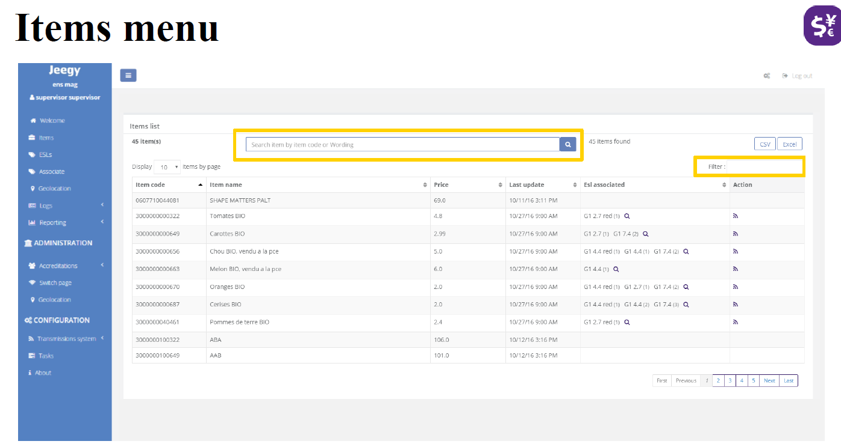
Competitor1’s UI – Item (產品/病床 Info. ) 1/3

Slide 14
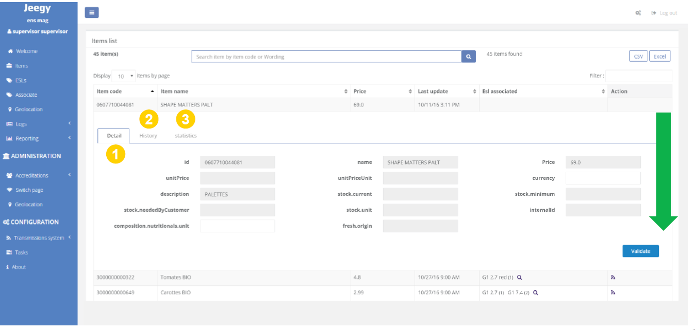
Competitor1’s UI – Item (產品/病床 Info. )2/3

Slide 15
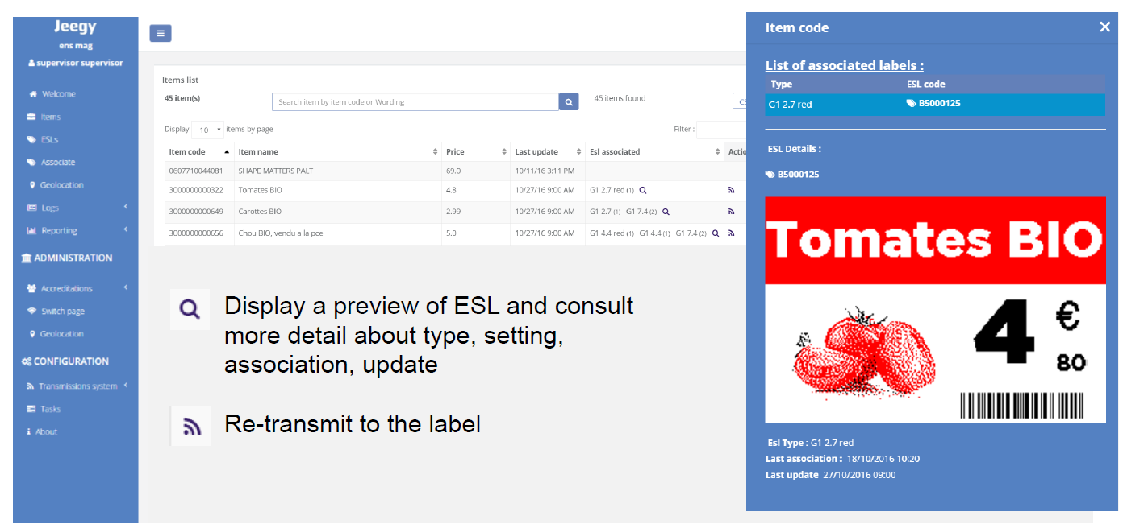
Competitor1’s UI – Item (產品/病床 Info. )3/3

Slide 16
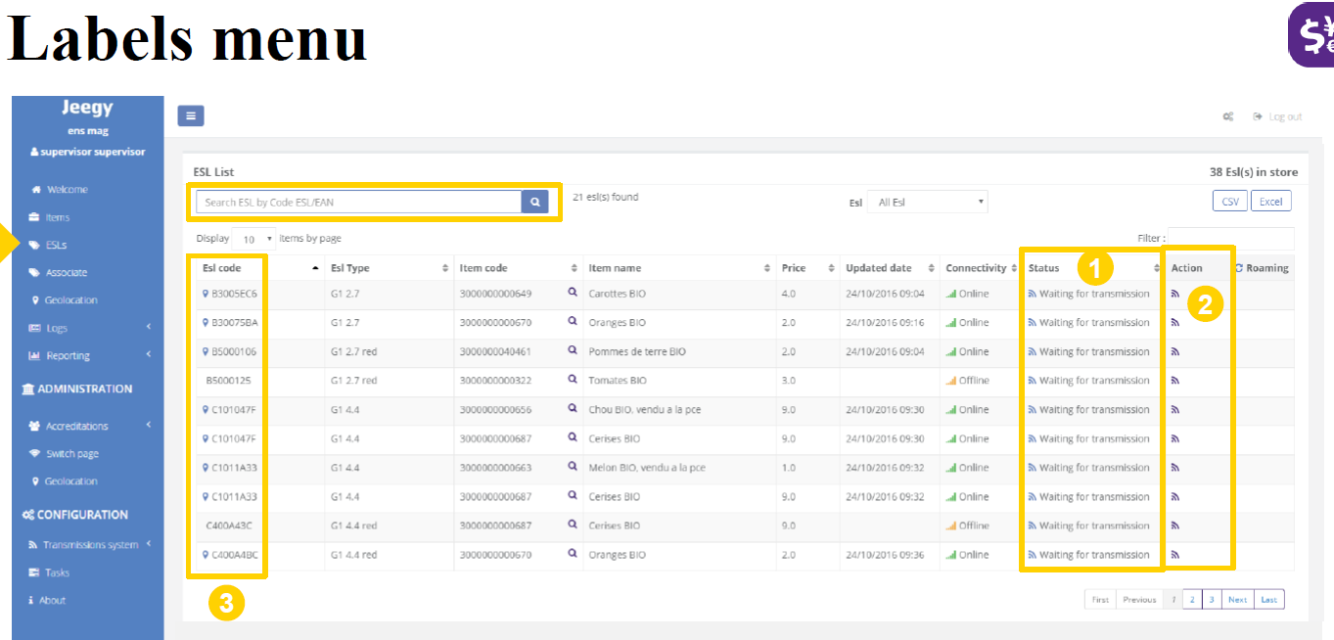
Competitor1’s UI – Device Mgt 1/4

Slide 17
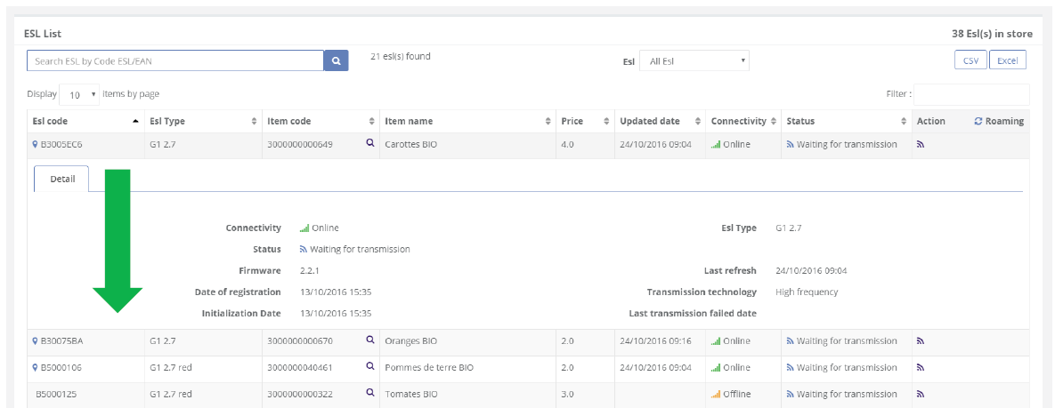
Competitor1’s UI – Device Mgt 2/4

Slide 18
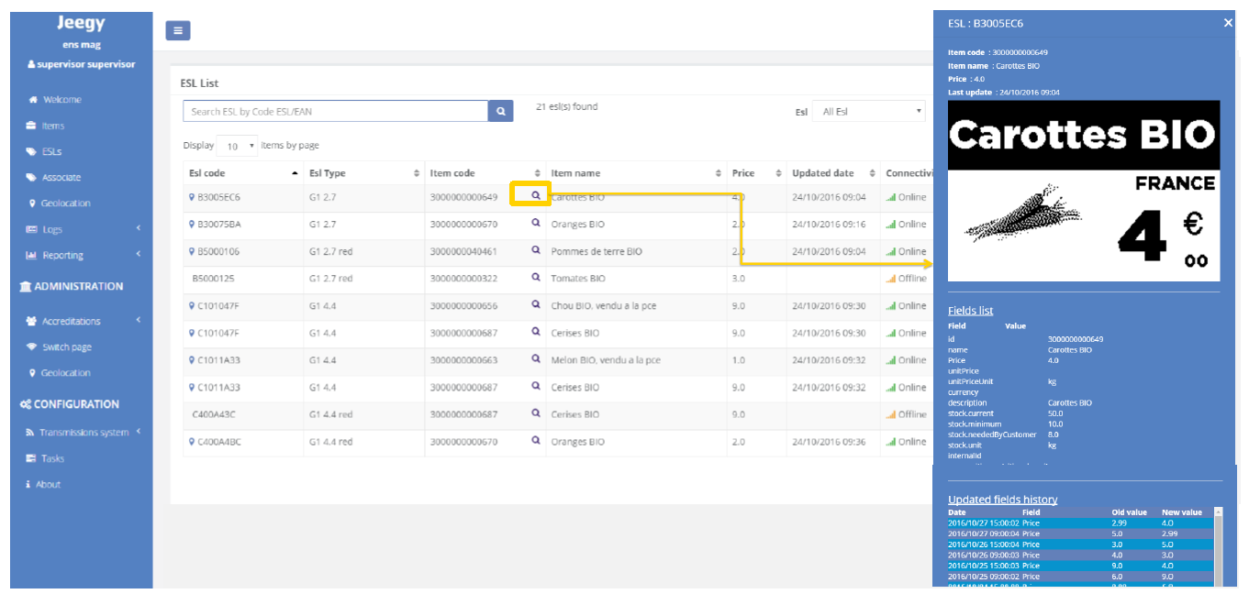
Competitor1’s UI – Device Mgt 3/4

Slide 19
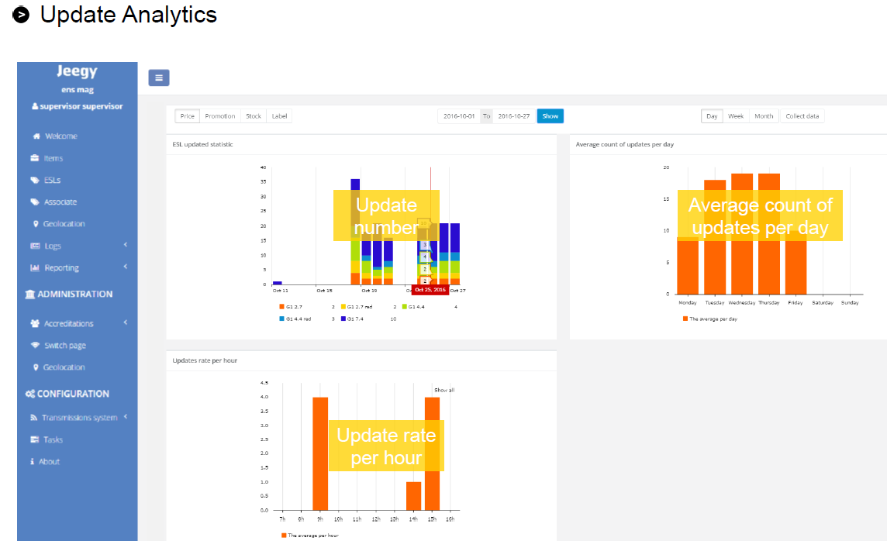
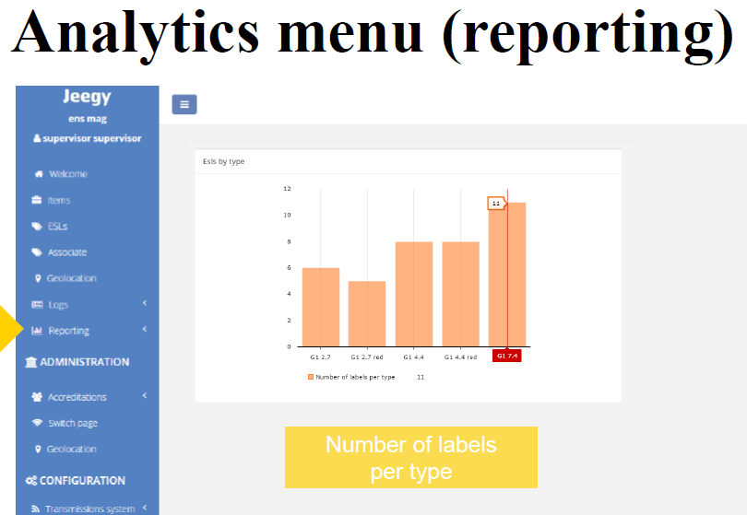
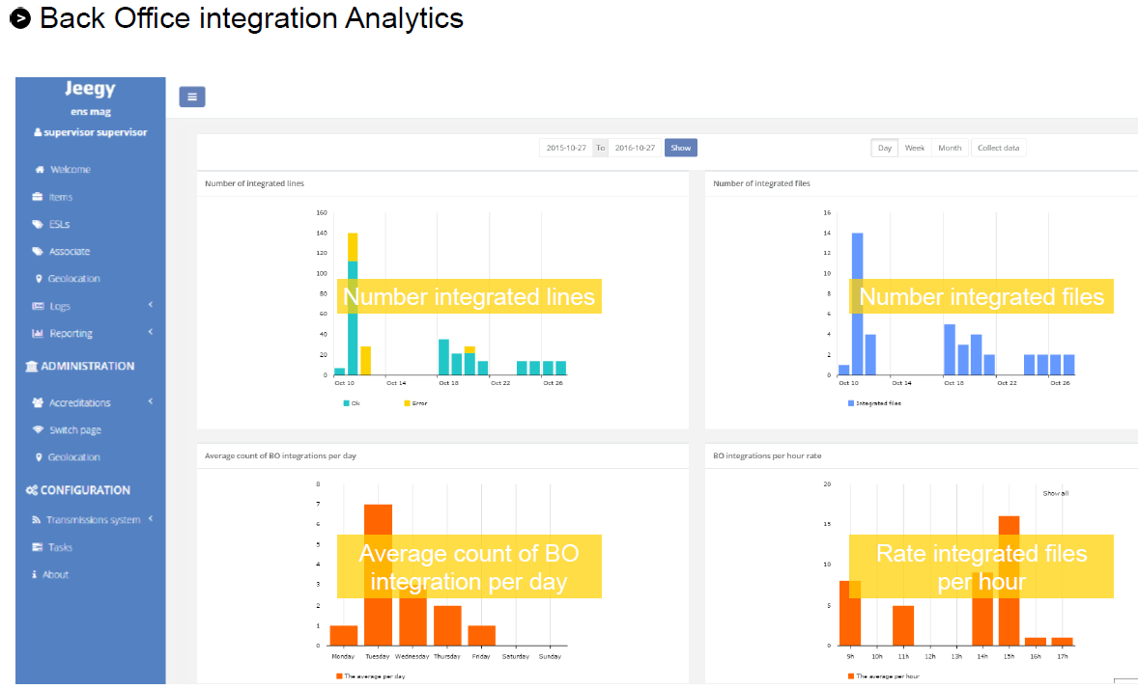
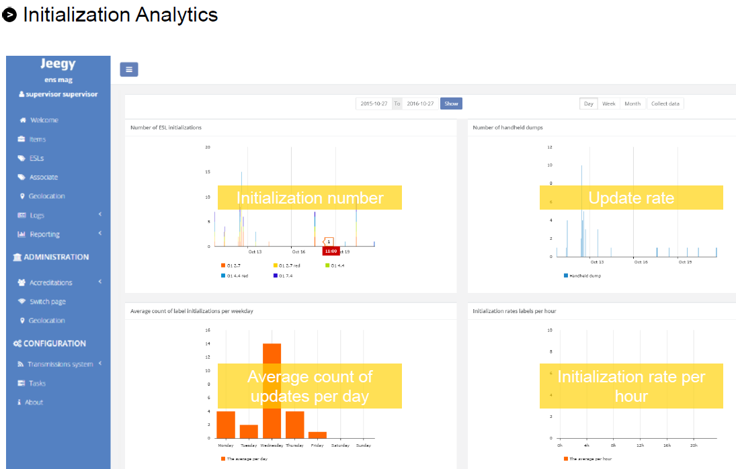
Competitor1’s UI – Device Mgt 4/4

Slide 20
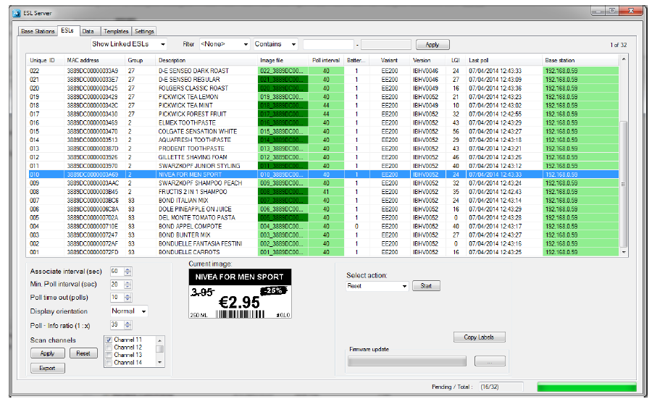
Competitor2’s UI – Device Mgt 1/2

Slide 21
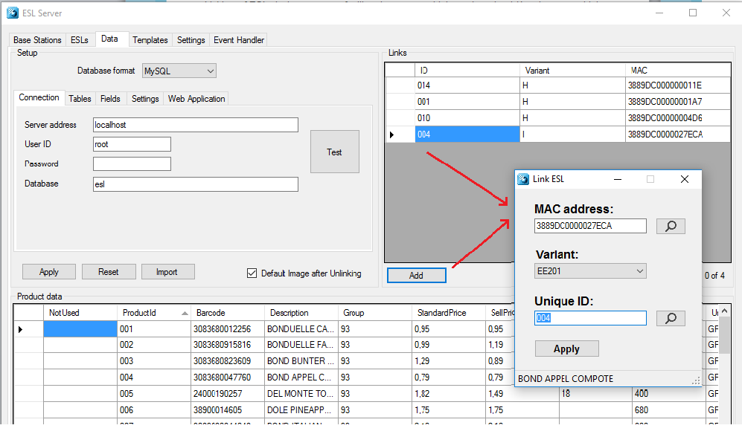
Competitor2’s UI – Device Mgt 2/2

Slide 22
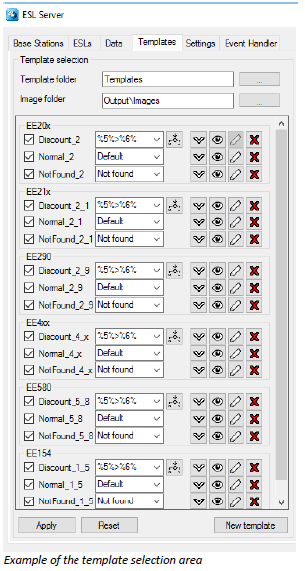
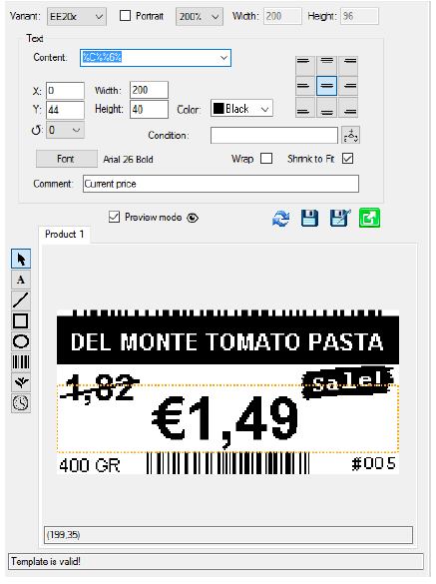
Competitor2’s UI – Image Generator

Slide 23
Thank You!

