Slide 1
How to evaluate model with TensorBoard
Embedded Core Group
Ivan.Chen
2016/09/01

Slide 2
Outline
What is Overfitting (過擬合)
Analyze Overfitting By TensorBoard
How to add TensorBoard logs

Slide 3
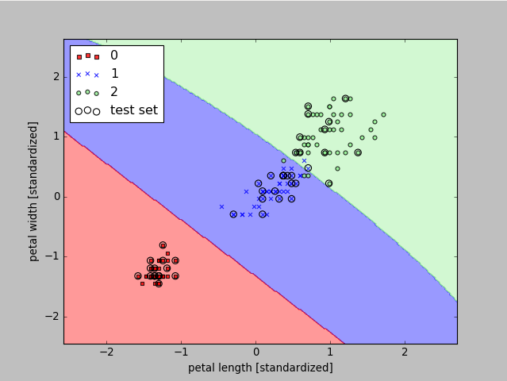
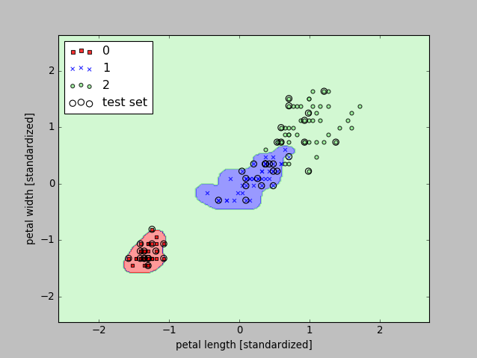
What is Overfitting
Good Compromise
(SVM algorithm gamma=0.1)
Overfitting
(SVM algorithm gamma=100)

Slide 4
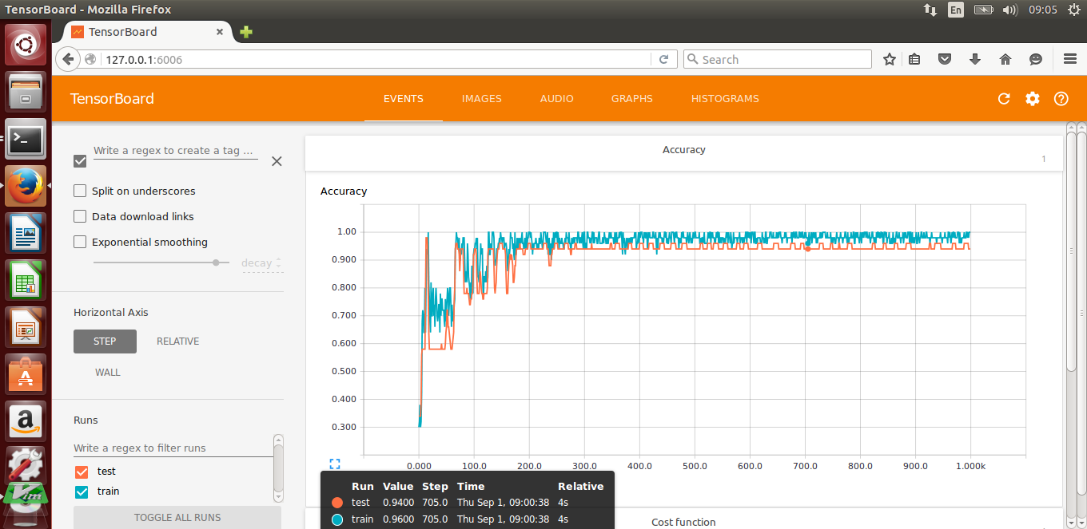
Analyze Overfitting By TensorBoard
Train data accuracy:0.96
Test data accuracy: 0.94
accuracy gap: 0.02 (gap 越大表示overfitting 越大)

Slide 5
How to add TensorBoard logs

Slide 6
Build TensorFlow Graph
y: 預測的 labels
y_ : 正確分類的 lables
3
3
softmax(out)
150
y
150
y_
TensorFlow graph for “y“, “y_”
y = tf.nn.softmax(out)
y_ = tf.placeholder(tf.float32, [None, 3])
TensorFlow graph for accuracy
correct_prediction = tf.equal(tf.argmax(y,1), tf.argmax(y_,1))
accuracy = tf.reduce_mean(tf.cast(correct_prediction, "float"))

Slide 7
Add TensorBoard Logs
#在 accuracy node 附加 scalar_summary 操作來輸出 accuracy 值
tf.scalar_summary(‘Accuracy', accuracy)
#匯總所有的summary操作
merged_summary_op = tf.merge_all_summaries()
#指定寫入summary的檔案路徑
test_writer = tf.train.SummaryWriter(‘./logs')
#在每次訓練時增加summary 到檔案中
for i in range(1000):
test_str, acc = sess.run([merged_summary_op, accuracy],
feed_dict={inp: [x for x in testSet[keys].values],
y_: [x for x in testSet['One-hot'].values]})
test_writer.add_summary(test_str, i)

Slide 8
Launch TensorBoard
啟動TensorBoard 並指定logs 位置:
$tensorboard –loddir==/mnt/logs
使用瀏覽器顯示logs.
位置: 127.0.0.1:6006

Slide 9
Demo

