Slide 1
EdgeX - Export to WISE-Cloud
Terry Lu, Embedded Computing Group
2019/02/11

Slide 2
Agenda
Data Flow
WISE-Agent Device Service (Receive Data)
Export Registration (EdgeX Configuration)
EdgeX Handler (Export Data)

Slide 3
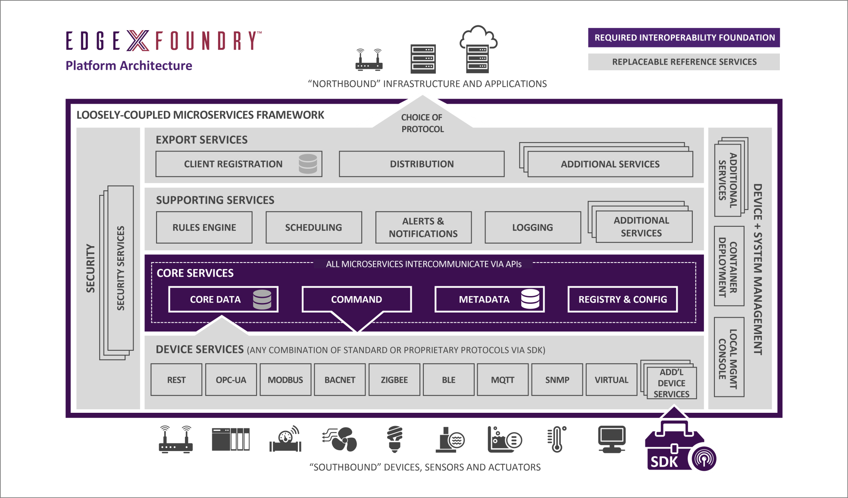

Slide 4
Data Flow
WISE-Cloud
Export Registration
Export Distribution
EdgeX
Core Data
Wise Agent
EdgeSense
EdgeX- Adv
Wise-Agent
Device Service
To EdgeX
EdgeX Handler
To WISE-Cloud
Internal Broker
3.3 protocol
2.0 protocol
Southbound
Agent
Wise Agent
ProcessHandler

Slide 5
WISE-Cloud
Export Registration
Export Distribution
Core Data
Wise Agent
Wise-Agent
Device Service
EdgeX Handler
Internal Broker
3.3 protocol
2.0 protocol
Southbound
Agent
Wise Agent
ProcessHandler

Slide 6
WISE-Agent Device Service Example - Go
WISE-Agent device will receive cpu usage and memory info from wise-agent process handler and bypass data to EdgeX.

Slide 7
WISE-Cloud
Export Registration
Export Distribution
Core Data
Wise Agent
Wise-Agent
Device Service
EdgeX Handler
Internal Broker
3.3 protocol
2.0 protocol
Southbound
Agent
Wise Agent
ProcessHandler

Slide 8
Export Registration
We add a new registration to export data to internal broker.
curl -X POST -H "Accept:application/json" -d ' Json String' http://localhost:48071/api/v1/registration

Slide 9
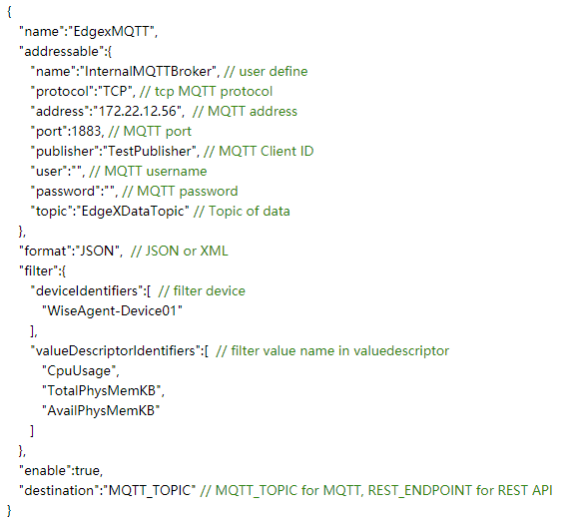

Slide 10
WISE-Cloud
Export Registration
Export Distribution
Core Data
Wise Agent
Wise-Agent
Device Service
EdgeX Handler
Internal Broker
3.3 protocol
2.0 protocol
Southbound
Agent
Wise Agent
ProcessHandler

Slide 11
EdgeX Handler
EdgeX Handler will receive sensor data from EdgeX and bypass data to WISE-Cloud.

Slide 12
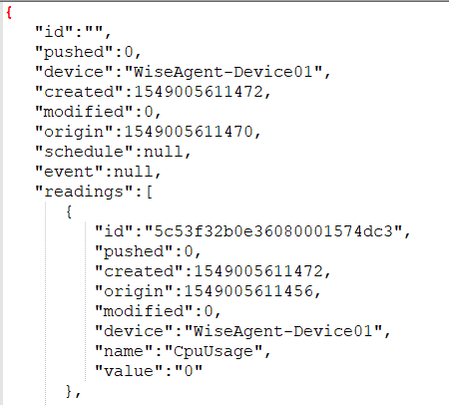
Data Receive in WISE-Agent Device

Slide 13
Source Link
WISE-Agent Device
http://advgitlab.eastasia.cloudapp.azure.com/EdgeSense/EdgeX-WiseAgent-Device
http://ess-wiki.advantech.com.tw/view/WiseAgent_Device_Service
EdgeX Handler
http://advgitlab.eastasia.cloudapp.azure.com/EI-PaaS-RMM/RMM-EI-Agent/tree/develop/Modules/EdgeXHandler

Slide 14
Go Together,
We Go Far and Grow Big

Slide 15
