Slide 1
EWM-W168 porting note
Rsb-4411
Liszt Kao, ESS-RISC, Embedded-IoT
2019/04/16

Slide 2
Outline
Wi-Fi driver
Bluetooth

Slide 3
Wi-Fi Driver
Add configuration in Makefile
CONFIG_PLATFORM_ARM_IMX6QD = y
CONFIG_RTL8822B = y
ifeq ($(CONFIG_PLATFORM_ARM_IMX6QD), y)
EXTRA_CFLAGS += -DCONFIG_LITTLE_ENDIAN -DCONFIG_PLATFORM_ANDROID
EXTRA_CFLAGS += -DCONFIG_CONCURRENT_MODE
EXTRA_CFLAGS += -DCONFIG_IOCTL_CFG80211 -DRTW_USE_CFG80211_STA_EVENT
EXTRA_CFLAGS += -DCONFIG_RADIO_WORKARCH := arm
CROSS_COMPILE :=../prebuilts/gcc/linux-x86/arm/arm-linux-androideabi-4.9/bin/arm-linux-androideabi-
KSRC :=../kernel_imx
MODULE_NAME := 8822be
endif
Build Command
make ARCH=arm KSRC=../kernel_imx/ CROSS_COMPILE=../prebuilts/gcc/linux-x86/arm/arm-linux-androideabi-4.9/bin/arm-linux-androideabi-

Slide 4
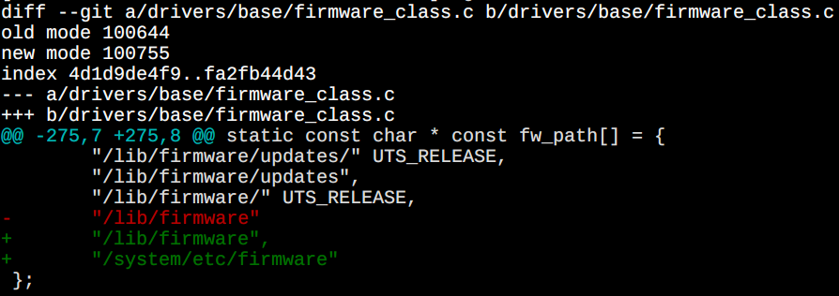
Bluetooth
Hal
The default Bluetooth have to be removed in ~/system/bt
Remove ADD-ON configuration in rtkbt.mk
#BOARD_HAVE_BLUETOOTH_RTK_ADDON := basic
Driver
Add pid/vid on rtk_btusb.c and set up module config & fw.
Using vfs_read instead of bdaddr_file->f_op->read because of read function is null.(header file)
Driver read MAC address at this (advantech.sh echo an new one while system boot up first time)
#define BDADDR_FILE "/data/misc/bluetooth/bdaddr“
For both config & fw be loaded, the firmware path /system/etc/firmware/ have to be included.(PATCH not included)

Slide 5
Bluetooth
Build driver module
export PATH=$PATH
export ARCH=arm
export CROSS_COMPILE=${PWD}/prebuilts/gcc/linux-x86/arm/arm-linux-androideabi-4.9/bin/arm-linux-androideabi-
OLD_PATH=${PATH}
export PATH=${PWD}/bootable/bootloader/uboot-imx/tools/:${PATH}
pushd ${PWD}/kernel_imx
make imx_v7_adv_android_defconfig
make modules -j$COREpopd
export PATH=${OLD_PATH}

Slide 6
Go Together,
We Go Far and Grow Big

