Slide 1
Deploy K8S with Ansible
Terry Lu, ESS-EdgeSense, Embedded-IoT
2019/04/16

Slide 2
Agenda
Introduce to Ansible
Inventory
Playbook
Task
Handler
Variable
Other Topics

Slide 3
Ansible
Deploy software to multi-hosts with SSH protocol.
Implement with python.

Slide 4
Ansible - Inventory
The config database of Ansible.
INI or YAML.
Config:
Host need to deploy.
Parameters of deployment.

Slide 5
Ansible - Inventory
The INI inventory file usually used to describe the hosts information.

Slide 6
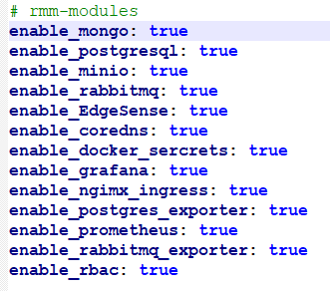
Ansible - Inventory
The YAML inventory usually used to config parameters of deployment.

Slide 7
Ansible - Playbooks
Playbooks is a list of tasks for deployment.
YAML
Command:
ansible-playbook -i INVENTORY playbook.yml

Slide 8
Ansible - Playbooks
Playbook
Play1
Tasks
task1:
task2:
…
Handlers
handler1:
…
Play2…

Slide 9
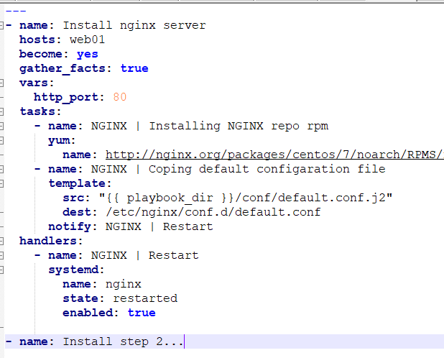
Ansible - Playbooks
hosts
plays
tasks
handlers

Slide 10
Ansible - Task
Modules

Slide 11
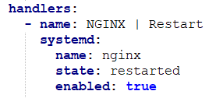
Ansible - Handlers
Handler is the task, but it define the error handle task instead of deploy task.

Slide 12
Ansible - Role
Ansible role is a group of tasks.

Slide 13
Ansible - Role
Playbook
Playbook
Play1
Play1
Tasks
task1:
task2:
…
Roles
Role1:
task1
Handler1
Handlers
handler1:
…
Role2:
task2
Play2…
Play2…

Slide 14
Ansible - Variable

Slide 15
Ansible - Other Topics
Loops
Template (Jinja2)
Ad-Hoc
Plugins
…

Slide 16
Reference
http://www.lawrencelin.info/2017/04/ansible-notes/

Slide 17
Go Together,
We Go Far and Grow Big

