Slide 1
Local Provision
Terry Lu, ESS-EdgeSense, Embedded-IoT
2019/04/03

Slide 2
Agenda
Local Provision Flow
Simple Protocol
Data Format
A Demo.

Slide 3
Local Provision Flow
Agent
Agent
Mcast, discover
LocalProvision
LocalProvision
Mcast, discover ack
Time
TCP, active
Mcast port: 9178
TCP port: 9177

Slide 4
Simple Protocol
Data size
Int32_t
length
Content
length
Raw data
AES(string1 + “\0” + string2 + “\0” + string3 + “\0” + …)

Slide 5
Data Format - Discover
Data size
Int32_t
16 bytes
Content
16
AES(“discover”)

Slide 6
Data Format - Discover ACK
Data size
Int32_t
16 bytes
Content
16
AES(“discover-ack”, “deviceID”)

Slide 7
Data Format - Active
Int32_t
N bytes
N
AES(“active”, “deviceID”, ”URL”, ”IoTKey”, ”TLS type”, ”CA file”,
”CA path”, “Cert file”, “Key file”, “Cert Password”)

Slide 8
Demo – Trigger Discover

Slide 9
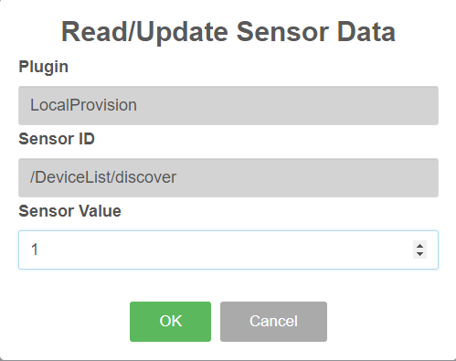
Demo – Trigger Discover

Slide 10
Demo – Discover ACK

Slide 11
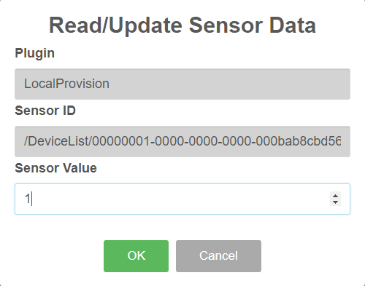
Demo – Active

Slide 12
Go Together,
We Go Far and Grow Big

