Slide 1
Introduction for IDP3.0 Qualification
Eric Liang
Embedded Core Group
2016/01/06

Slide 2
Outline
Overview
Installation
Run Qualification with UTX-3115
IPS
Issue

Slide 3
Overview
Diagnostics Tool
Obtaining Certification by Intel
Total 58 Test items
Hardware (33): Bt, Eth, GPIO, …
OS (6): UEFI Boot, UEFI Boot Service, UEFI Capsule Updae…
OS Application (6):Python, Lua, OpenJDK, OpenSSL, OSGi, SQLite3
OS Management (2): OMA-DM, TR-069
OS Security (8): Secure Boot, Signed Boot Loader, Encrypted Storage…
Processor (2): CPU, SOC Config
Communication (1): MQTT

Slide 4
Installation
Install from Intel’s Server to gateway
baseurl=http://198.175.66.251/WRL/7/extras
Install SOP
Folder
/opt/Intel/Diagnostics/gateway/HostScripts/UNIX/opt/intel/qualification/xxx
README.TXT: Test information, procedures, and categories
setup.sh: This is a test setup and initialization script that call qualify.sh
qualify.sh: Script that executes a test procedure and reports the results to setup.sh

Slide 5
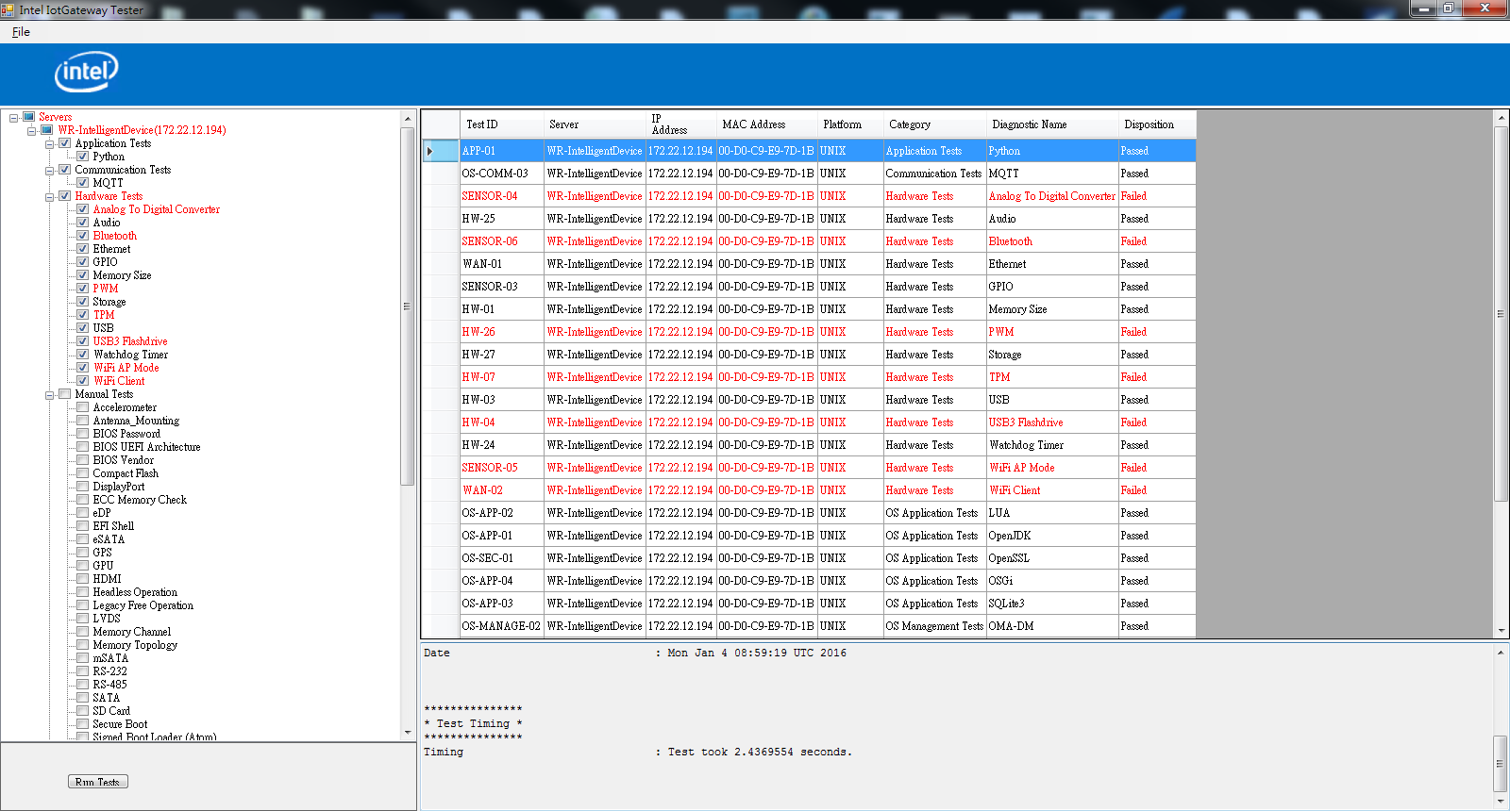
Run Qualification with UTX-3115
Auto ( 29 )
Manual ( 29 )
Dependence ( Wifi, BT, USB3 flash…)

Slide 6
Run Qualification with UTX-3115 (Cont.)
Bluetooth ( Auto )
Dependence: Assure that there is a Bluetooth device within range of the target that is advertising "ubuntu-0" as it's device ID
Procedure: 1. This test verifies Bluetooth functions by locating and pinging a Bluetooth device that is advertising a the device name “ubuntu-0”.
2. Run the test from the command line, execute the following commands from within the test folder : bash setup.sh
To modify my iPhone name to -> "ubuntu-0"

Slide 7
Run Qualification with UTX-3115 (Cont.)
RS-232 ( Manual )
/RS-232/README.TXT
Test Procedure:
Requirement : Half-duplex RS232-USB convert cable, Putty,
BIOS or hardware jumper settings properly
PROCEDURE: 1 ~ 9
RESULT
Use the Application Interface to report that if this manual test passed/failed

Slide 8
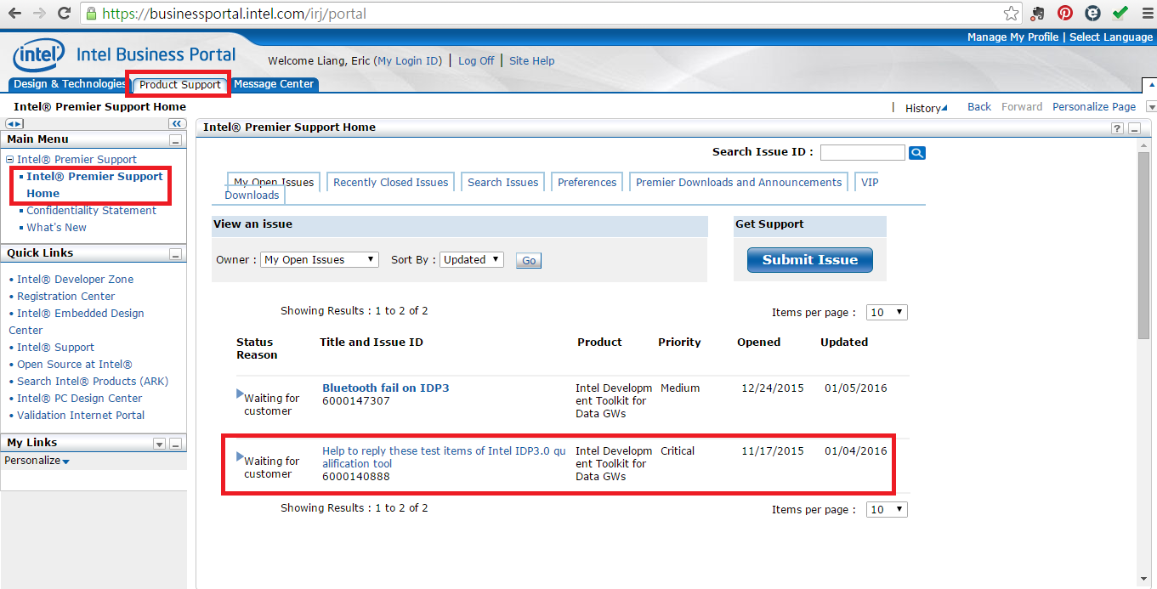
IPS

Slide 9
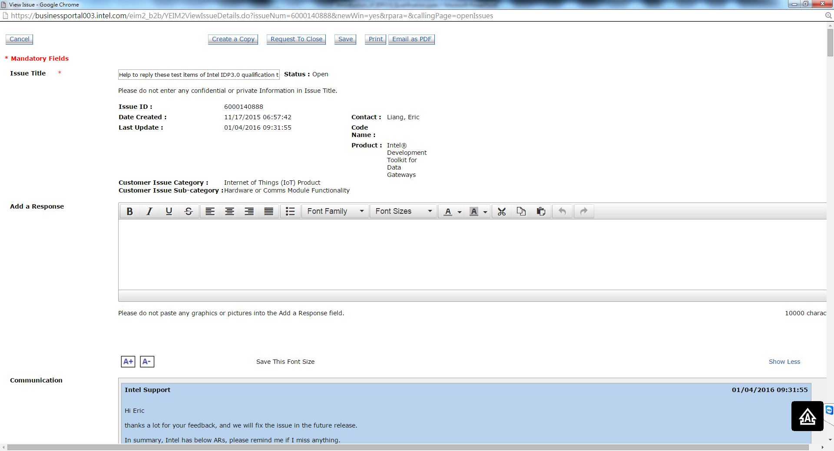
IPS (Cont.)

Slide 10
Issue of IDP3.0 Qualification
Item | Issue | Solution
1 | SRM limitation for diag tool installation | should be able to install diag tool when SRM is enabled
2 | Audio | need to modify driver module checking script and check the related audio hw device for audio codec
3 | USB | need to check if we need the partition 1 for testing, and related test pre-condition statement
4 | GRSecurity | need to check if we need to check policy file and related test pre-condition statement
5 | CPU | Need to add related missing CPU parts
6 | UEFI security boot | make the test from manual test to automatic test
7 | ECC memory check | make the test from manual test to automatic test.
8 | Memory channel check | make the test from manual test to automatic test.

