Slide 1
Introduce to EdgeX
Terry Lu, ESS-EdgeSense, Embedded-IoT
2018/12/26

Slide 2
Agenda
Architecture
EdgeX Microservice
Device Service
Core Service
Supporting Service
Export Service
Snapshot of Rule Engine
Device-Simple for Device Service Example
Roadmap

Slide 4
Architecture - Microservice (docker)

Slide 5
Rest API

Slide 7
Device Service
串接 sensor 與 core service
轉譯 sensor 資料格式與 core service 資料格式
使用 Rest API 與外界溝通
可銜接多個同類型的 sensor

Slide 9
MetaData
記錄 device service 與 sensor 的關係

Slide 11
Core Data
Data service 集中儲存 sensor data
Data client 取得 sensor data

Slide 12
Core Data – Save Sensor Data
Meta
Data
mongo
Device
Device
Service
Core
Data
Database

Slide 13
Core Data – Get Sensor Data
Meta
Data
Client
Core
Data
Database

Slide 15
Command
經由 device service 對 sensor 下達命令

Slide 16
Core Data – Save Sensor Data
Meta
Data
Client
Command
Device
Service
Device

Slide 18
Register & Config
Core Layer module 都可以使用 Rest API 跟 Consul 取得設定

Slide 19
Register & Config
Consul
https://www.consul.io/

Slide 20
Device Service

Slide 22
Export Service Data Flow
MQTT /Rest API
For rule engine / local service

Slide 23
Client Registration
3. MQTT / Rest API
Client 使用 rest API 註冊:
Export 的 sensor
Export 的 format
Export 的方法(MQTT / Rest API)
2. format
Micro Service
1. Device / Sensor

Slide 25
Rule Engine
Open source Drools
https://www.drools.org/

Slide 28
Simple Driver

Slide 29
Simple Driver

Slide 30
Reference
EdgeX document
https://nexus.edgexfoundry.org/content/sites/docs/staging/master/docs/_build/html/index.html
EdgeX github
https://github.com/edgexfoundry/support-rulesengine

Slide 31
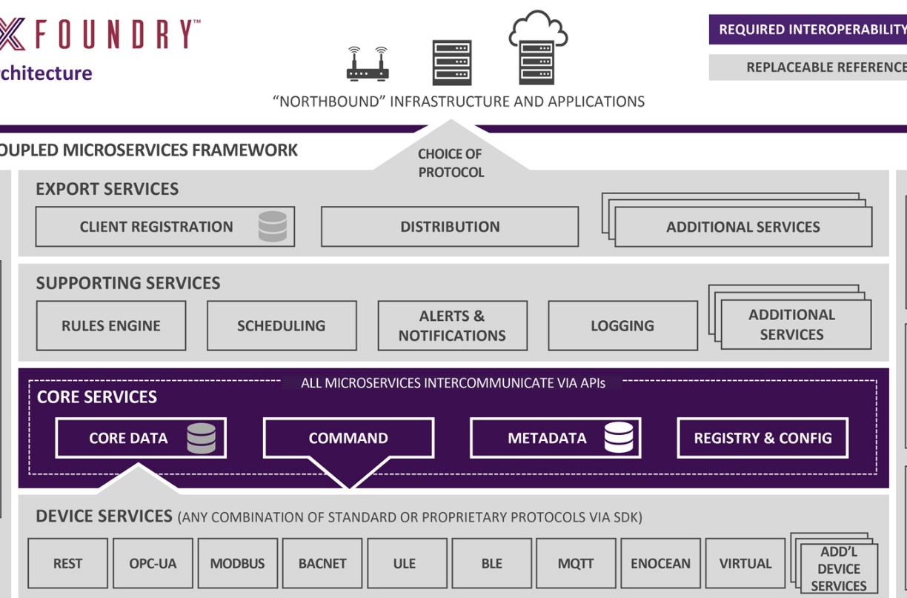
WISE-PaaS/EdgeSense
Northbound
Southbound

Slide 32
EdgeX / EdgeSense Roadmap
Available
Developing
Planning
Sprint - III
EdgeX / EdgeSense-Southbound
- Downlink
- OTA
Sprint - II
Sprint - I
EdgeX / WISE-PaaS/EdgeSense
- Uplink
EdgeX / Docker
EdgeX / Windows 10
EdgeX / Ubuntu 16.04
2019 / Jan
2019 / Mar
2019/ May

Slide 33
Go Together,
We Go Far and Grow Big

